Slide 1


Navigating Your Casio Calculator $fx−991EX ClassWiz$
jfrost@tiffin.kingston.sch.uk
www.drfrostmaths.com
@DrFrostMaths
Last modified: 28th March 2017

Slide 2
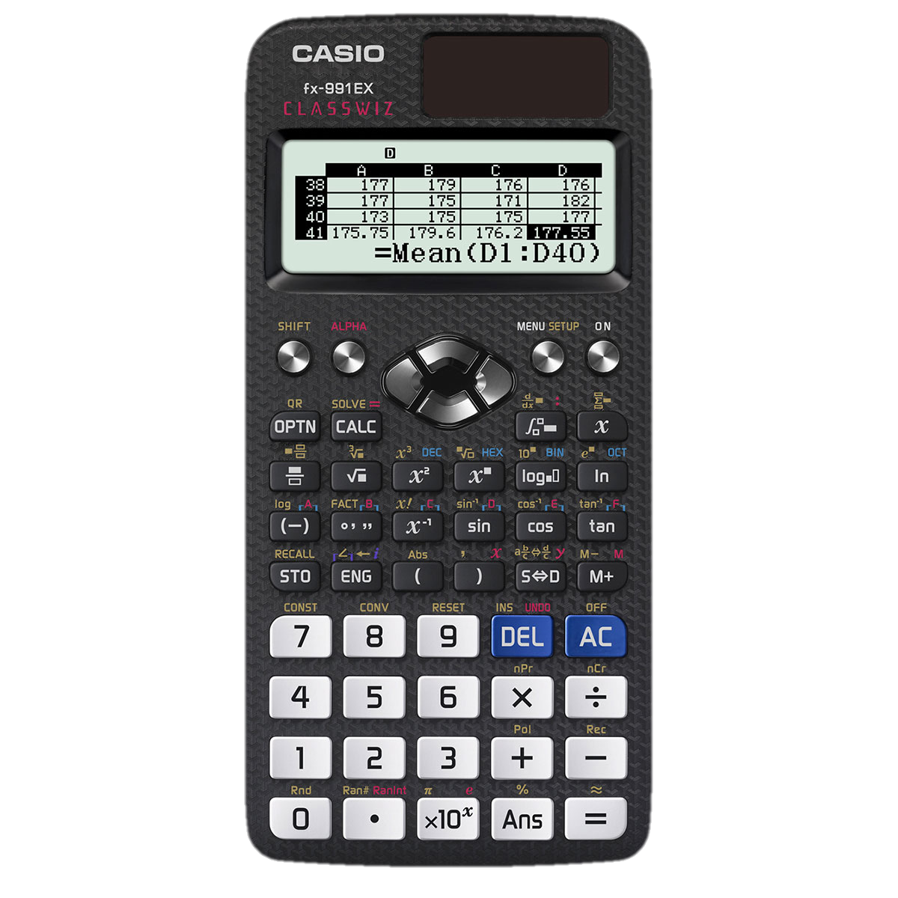
Click a button.
For details on statistical calculations, matrices, statistical distribution calculations, solving polynomials/simultaneous equations, complex numbers, etc. press the ‘Menu’ button.

Slide 3
You didn’t press a button for which information is provided. Click the button below to go back.
< Return

Slide 4












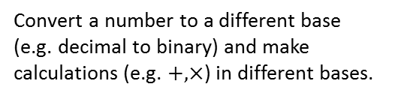
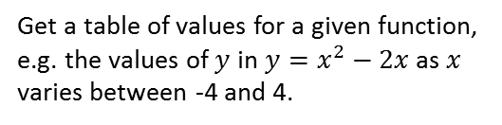
Mode Menu
On your calculator, use the arrow keys to select a mode then press =.
Click a mode below to find out more.
< Return
1: Calculate
2: Complex
3: Base-N
Normal calculation.
Make calculations with complex numbers, including conversion between Cartesian and mod-arg form.
Convert a number to a different base (e.g. decimal to binary) and make calculations (e.g. $+, ×$) in different bases.
4: Matrix
5: Vector
6: Statistics
Multiply matrices, raise to a power, transpose or find the inverse or determinant.
Find the dot or cross product of two vectors, or find the angle between two vectors.
Make calculations from a variable or frequency table, including mean, standard deviation, PMCC and regression lines.
7: Distribution
8: Spreadsheet
9: Table
Get values from Binomial, Poisson and Normal tables, including inverse-Z tables.
Like Excel, allows you to input data and make calculations (e.g. Mean) based on cell ranges.
Get a table of values for a given function, e.g. the values of $y$ in $y=x^{2}−2x$ as $x$ varies between -4 and 4.
A: Equation/Func
B: Inequality
C: Ratio
Solve linear simultaneous equations and polynomial equations (i.e. quadratics, cubics, quartics).
Solve quadratic inequalities (as well as cubic and quartic inequalities).
Find a missing value in two equivalent ratios.

Slide 5
Special Buttons
< Return
SHIFT
If you press a button after pressing SHIFT, it will use the operation indicated by the gold text above that button.
ALPHA
If you press a button after pressing ALPHA, it will use the operation or letter indicated by the red text above that button.
The letter X is particularly useful for entering a function. Click the ‘MODE’ button then ‘TABLE’ for more information.

Slide 6
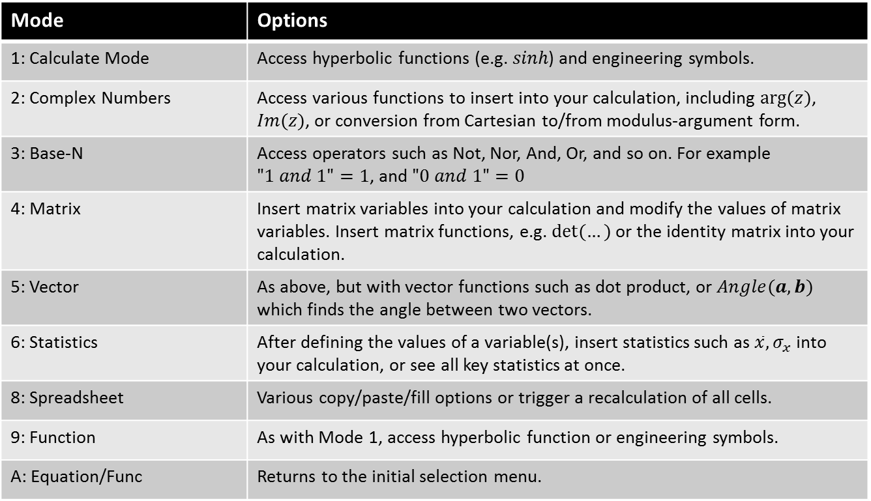
Options
< Return
OPTN
This provides a number of options depending on the current calculator mode. See each mode on this Powerpoint for more information.
Mode | Options
1: Calculate Mode | Access hyperbolic functions (e.g. $sinh$) and engineering symbols.
2: Complex Numbers | Access various functions to insert into your calculation, including $arg⁡(z)$, $Im(z)$, or conversion from Cartesian to/from modulus-argument form.
3: Base-N | Access operators such as Not, Nor, And, Or, and so on. For example $"1 and 1"=1$, and $"0 and 1"=0$
4: Matrix | Insert matrix variables into your calculation and modify the values of matrix variables. Insert matrix functions, e.g. $det⁡(…)$ or the identity matrix into your calculation.
5: Vector | As above, but with vector functions such as dot product, or $Angle(a,b)$ which finds the angle between two vectors.
6: Statistics | After defining the values of a variable(s), insert statistics such as $\overline{x}, σ_{x}$ into your calculation, or see all key statistics at once.
8: Spreadsheet | Various copy/paste/fill options or trigger a recalculation of all cells.
9: Function | As with Mode 1, access hyperbolic function or engineering symbols.
A: Equation/Func | Returns to the initial selection menu.
Go >

Slide 7
Arrow Buttons
< Return
You can use the up and down arrow buttons to retrieve previous calculations (a bit like your internet browser’s ‘Back’ and ‘Forward buttons!)
Use the left and right button after enter a calculation to navigate back through it, for example if you used a wrong value within a larger expression but don’t want to type the whole thing again.
The arrow buttons are also used when navigating a table (e.g. in Statistics mode) and selecting a calculator mode from the Menu.

Slide 8
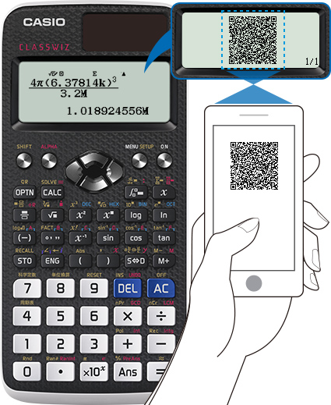
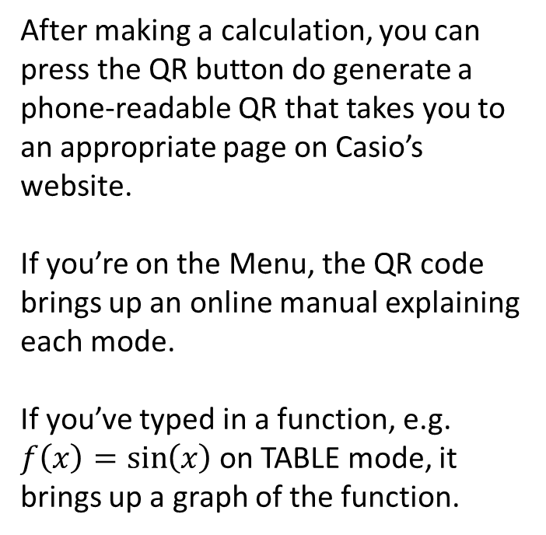
QR Codes
< Return
After making a calculation, you can press the QR button do generate a phone-readable QR that takes you to an appropriate page on Casio’s website.
If you’re on the Menu, the QR code brings up an online manual explaining each mode.
If you’ve typed in a function, e.g. $f\left(x\right)=\sin\left(x\right)$ on TABLE mode, it brings up a graph of the function.

Slide 9
On
< Return
On
Engineers are yet to discover the true nature of this button, which has eluded mankind for centuries.
But some mathematicians have theorised that pressing this button turns the calculator on.

Slide 10
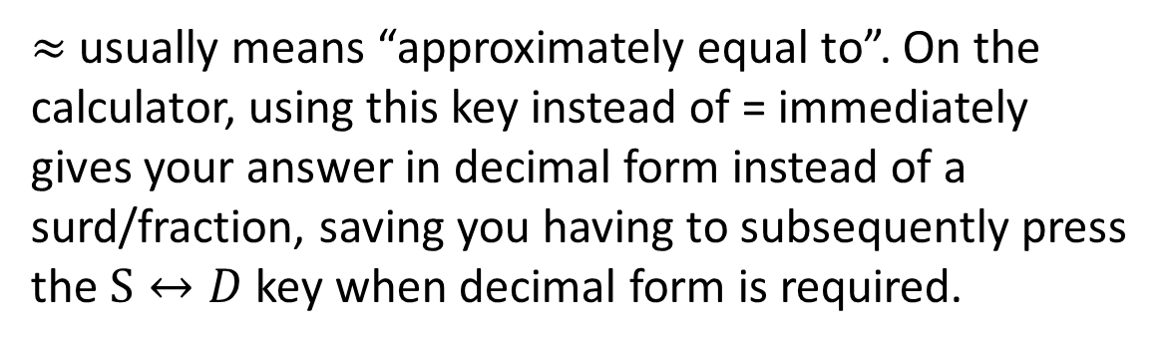

Approximately Equal
< Return
$$≈$$
$≈$ usually means “approximately equal to”. On the calculator, using this key instead of = immediately gives your answer in decimal form instead of a surd/fraction, saving you having to subsequently press the $S↔D$ key when decimal form is required.

Slide 11
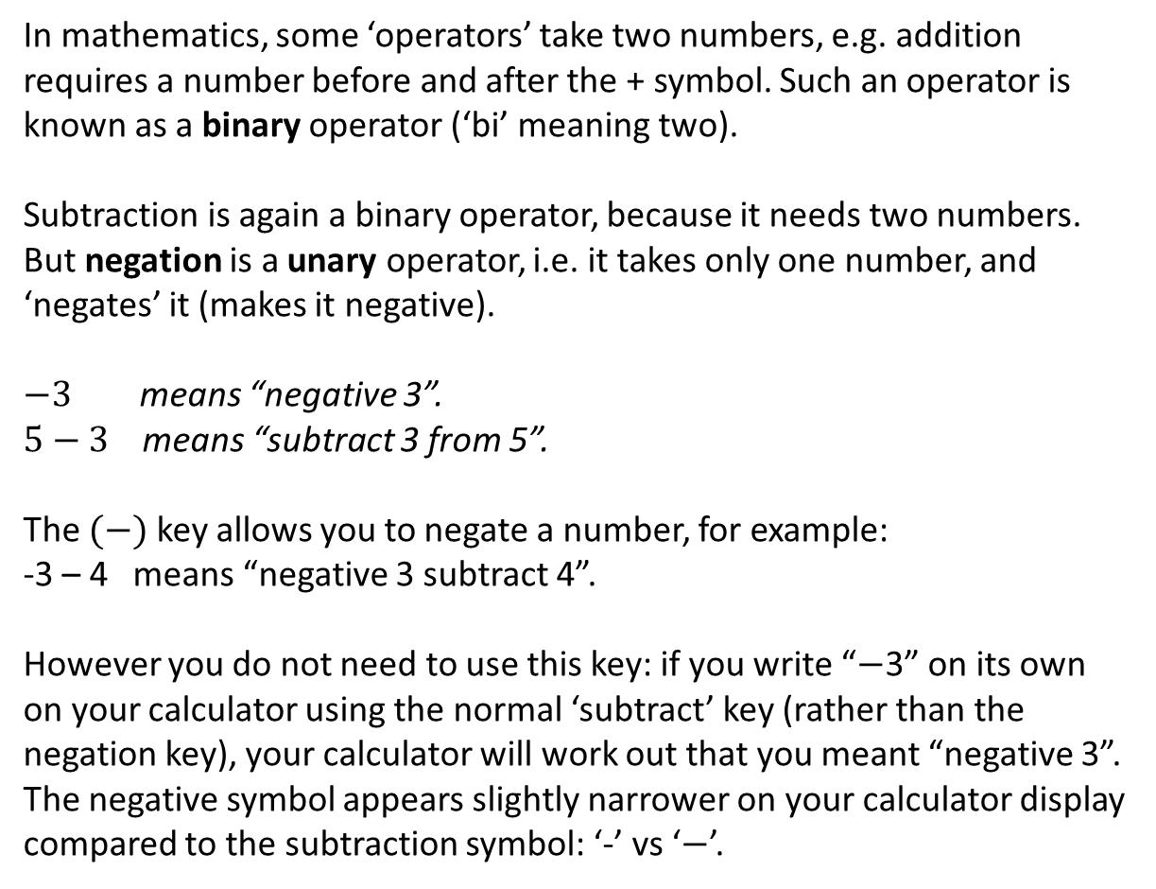

Negation vs Subtraction
< Return
$$(−)$$
In mathematics, some ‘operators’ take two numbers, e.g. addition requires a number before and after the + symbol. Such an operator is known as a binary operator (‘bi’ meaning two).
Subtraction is again a binary operator, because it needs two numbers. But negation is a unary operator, i.e. it takes only one number, and ‘negates’ it (makes it negative).
$−3$ means “negative 3”.
$5−3$ means “subtract 3 from 5”.
The $(−)$ key allows you to negate a number, for example:
-3 – 4 means “negative 3 subtract 4”.
However you do not need to use this key: if you write “$−$3” on its own on your calculator using the normal ‘subtract’ key (rather than the negation key), your calculator will work out that you meant “negative 3”.
The negative symbol appears slightly narrower on your calculator display compared to the subtraction symbol: ‘-’ vs ‘$−$’.

Slide 12

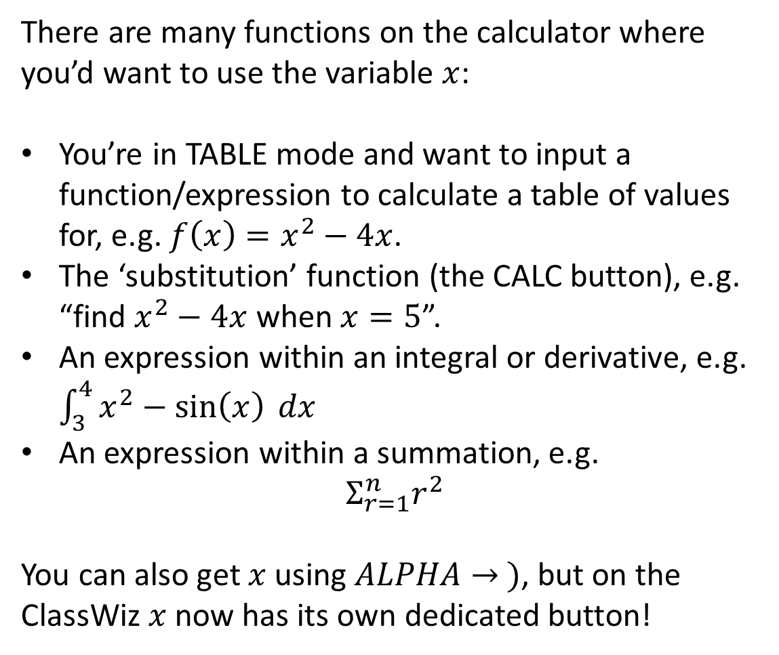
$$x$$
< Return
$$x$$
There are many functions on the calculator where you’d want to use the variable $x$:
You’re in TABLE mode and want to input a function/expression to calculate a table of values for, e.g. $f\left(x\right)=x^{2}−4x$.
The ‘substitution’ function (the CALC button), e.g. “find $x^{2}−4x$ when $x=5$”.
An expression within an integral or derivative, e.g. $\int_{3}^{4}{x^{2}−\sin\left(x\right) dx}$
An expression within a summation, e.g.
$Σ_{r=1}^{n}r^{2}$
You can also get $x$ using $ALPHA→ )$, but on the ClassWiz $x$ now has its own dedicated button!

Slide 13
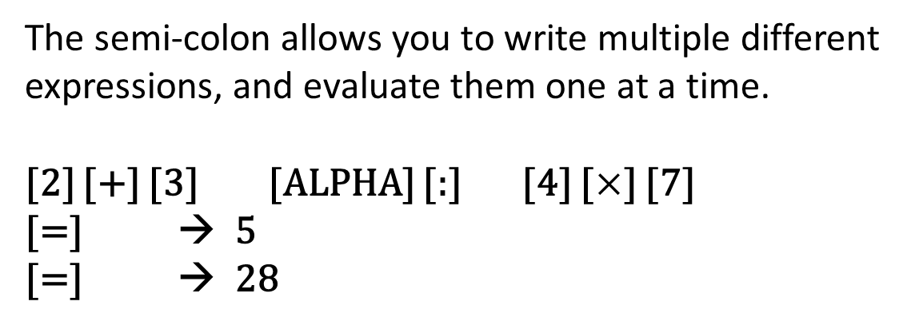
Multi-Statements
< Return
The semi-colon allows you to write multiple different expressions, and evaluate them one at a time.
[2] [+] [3] [ALPHA] [:] [4] [$×$] [7]
[=] → 5
[=] → 28
:

Slide 14
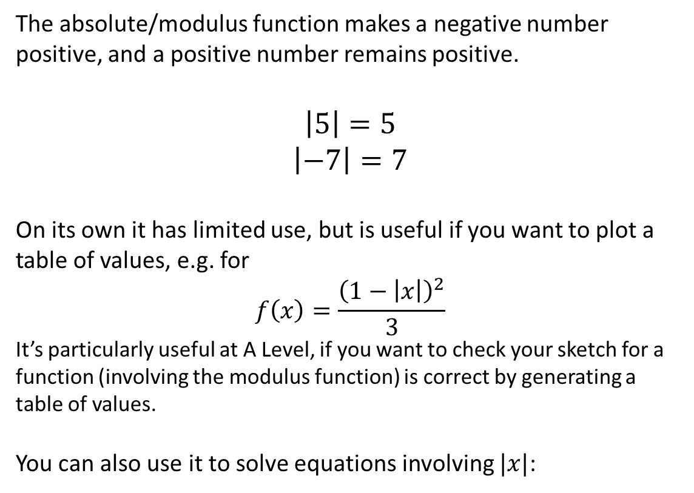
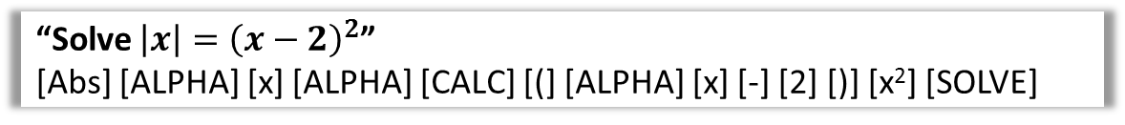
The Absolute Function
< Return
Abs
The absolute/modulus function makes a negative number positive, and a positive number remains positive.
$$\left|5\right|=5$$
$$\left|−7\right|=7$$
On its own it has limited use, but is useful if you want to plot a table of values, e.g. for
$$f\left(x\right)=\frac{{\left(1−\left|x\right|\right)}^{2}}{3}$$
It’s particularly useful at A Level, if you want to check your sketch for a function (involving the modulus function) is correct by generating a table of values.
You can also use it to solve equations involving $|x|$:
“Solve $\left|x\right|={\left(x−2\right)}^{2}$”
[Abs] [ALPHA] [x] [ALPHA] [CALC] [(] [ALPHA] [x] [-] [2] [)] [x²] [SOLVE]

Slide 15



The Reciprocal Function
< Return
$x$⁻¹
From Laws of Indices, you may have learnt that
$$x^{−1}=\frac{1}{x}$$
This is known as the ‘reciprocal’ of $x$.
[6] [$x$⁻¹] = 1/6
[1/7] [$x$⁻¹] = 7
It can also be used to find the inverse of matrices
(see [MODE] $→$ [MATRIX])

Slide 16
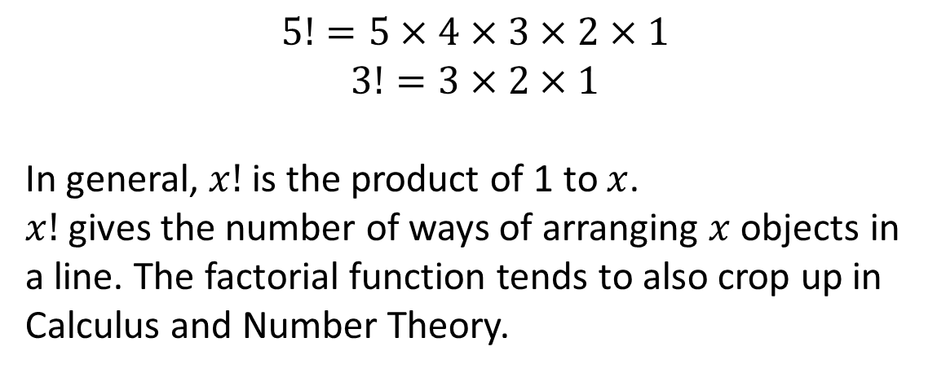


The Factorial Function
< Return
$$x!$$
$$5!=5×4×3×2×1$$
$$3!=3×2×1$$
In general, $x!$ is the product of 1 to $x$.
$x!$ gives the number of ways of arranging $x$ objects in a line. The factorial function tends to also crop up in Calculus and Number Theory.
$x$⁻¹

Slide 17
The Logarithm Function
< Return
log
Just as the ‘square root’ function is the opposite of ‘squaring’, log₂ for example is the opposite of finding 2 to the power of something.
log₂ 32 = 5, because 2⁵ = 32
log₃ 81 = 4, because 3⁴ = 81
Use the arrow keys to move between the boxes after pressing the button.
Note: Older Casios had a log button with no visible base (which was 10 by default). This has since been removed.

Slide 18
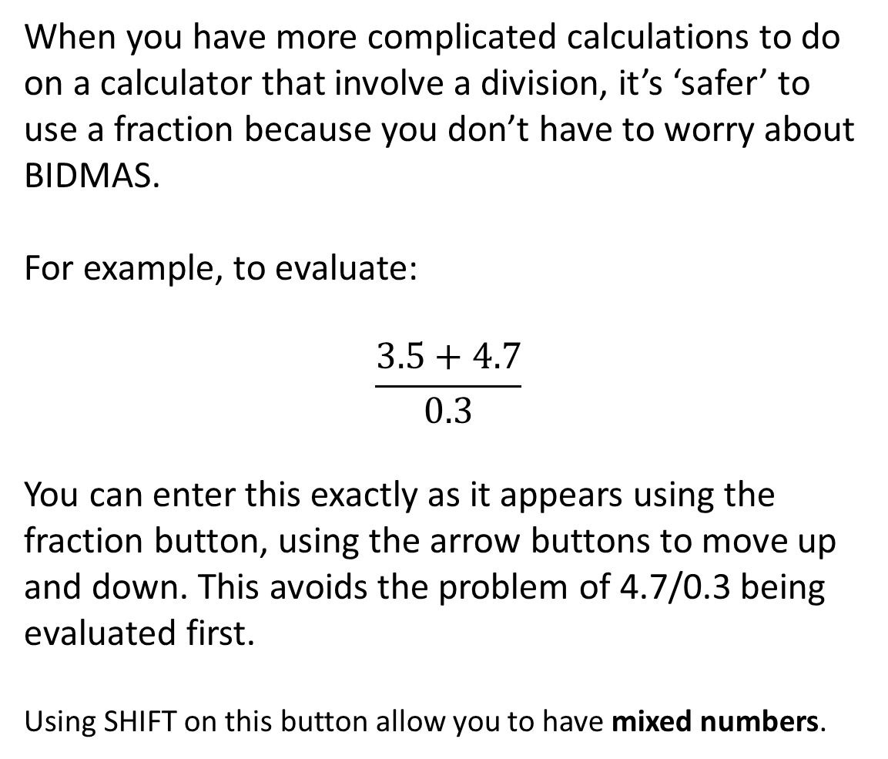
Fractions
< Return
When you have more complicated calculations to do on a calculator that involve a division, it’s ‘safer’ to use a fraction because you don’t have to worry about BIDMAS.
For example, to evaluate:
$$\frac{3.5+4.7}{0.3}$$
You can enter this exactly as it appears using the fraction button, using the arrow buttons to move up and down. This avoids the problem of 4.7/0.3 being evaluated first.
Using SHIFT on this button allow you to have mixed numbers.

Slide 19
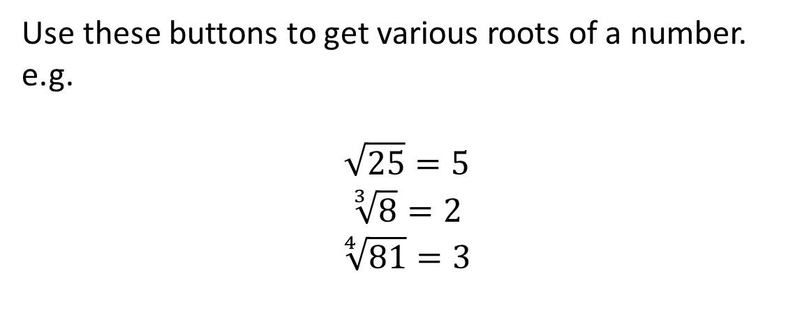
Root Functions
< Return
³√
Use these buttons to get various roots of a number.
e.g.
$$\sqrt{25}=5$$
$$\sqrt[3]{8}=2$$
$$\sqrt[4]{81}=3$$
√
√

Slide 20
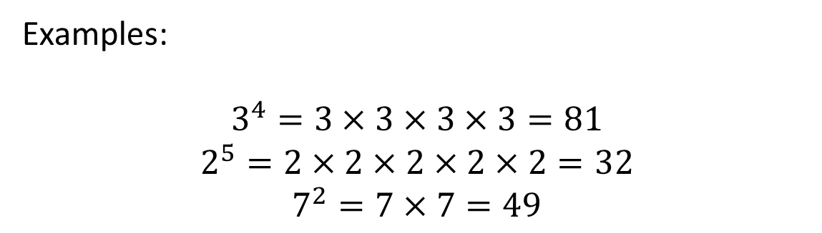

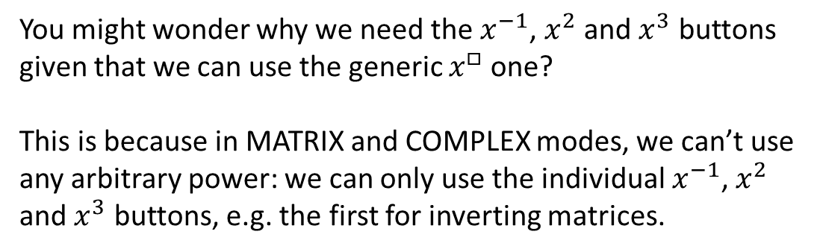
Powers
< Return
$$x^{□}$$
Examples:
$$3^{4}=3×3×3×3=81$$
$$2^{5}=2×2×2×2×2=32$$
$$7^{2}=7×7=49$$
You might wonder why we need the $x^{−1}$, $x^{2}$ and $x^{3}$ buttons given that we can use the generic $x^{□}$ one?
This is because in MATRIX and COMPLEX modes, we can’t use any arbitrary power: we can only use the individual $x^{−1}$, $x^{2}$ and $x^{3}$ buttons, e.g. the first for inverting matrices.

Slide 21
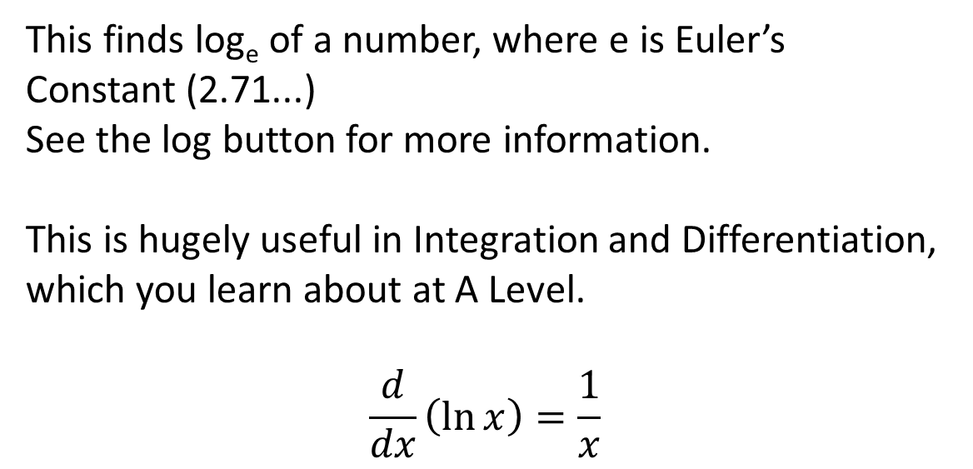
Natural Logarithm
< Return
ln
This finds log_{e} of a number, where e is Euler’s Constant (2.71...)
See the log button for more information.
This is hugely useful in Integration and Differentiation, which you learn about at A Level.
$$\frac{d}{dx}\left(\ln{x}\right)=\frac{1}{x}$$

Slide 22
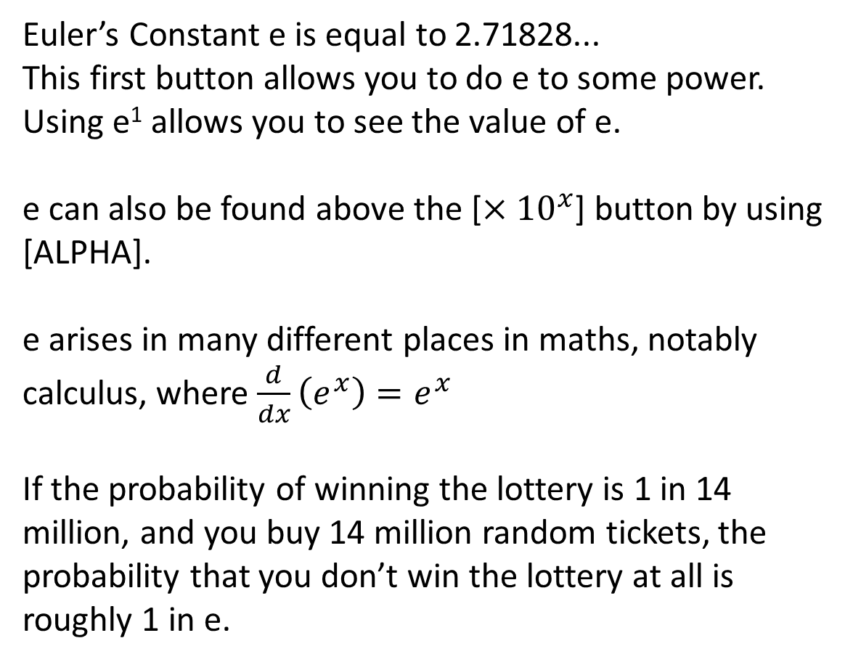
Euler’s Constant
< Return
e
Euler’s Constant e is equal to 2.71828...
This first button allows you to do e to some power. Using e¹ allows you to see the value of e.
e can also be found above the [$×{10}^{x}$] button by using [ALPHA].
e arises in many different places in maths, notably calculus, where $\frac{d}{dx}\left(e^{x}\right)=e^{x}$
If the probability of winning the lottery is 1 in 14 million, and you buy 14 million random tickets, the probability that you don’t win the lottery at all is roughly 1 in e.
e

Slide 23


Degrees, Minutes, Seconds
< Return
$${° }^{′ }′′$$
When you have some angle or time as a decimal, press this key to convert it to degrees, minutes (a 60th of a degree) and seconds (a 60th of a minute).
$$4.75 \left[=\right] → 4.75$$
$[°^{′}′′]$ $→ 4°{45}^{′}0′′$
or…
$4.75 [{° }^{′} ′′]$ $→ 4°{45}^{′}0′′$
This makes sense as 4.75 hours is 4 hours and 45 minutes.
Fun fact: Whereas the ‘decimal’ system is base 10 (i.e. each digit can have one of 10 values: 0 to 9), the ‘sexagesimal’ system is base 60. Subdivisions of hours and degrees are in sexagesimal.

Slide 24
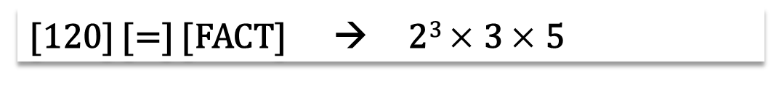
Factorise
< Return
FACT
This finds the prime factorisation of a number.
You need to enter the number first, then press =. THEN use the FACT button.
[120] [=] [FACT] → 2³ $×$ 3 $×$ 5

Slide 25
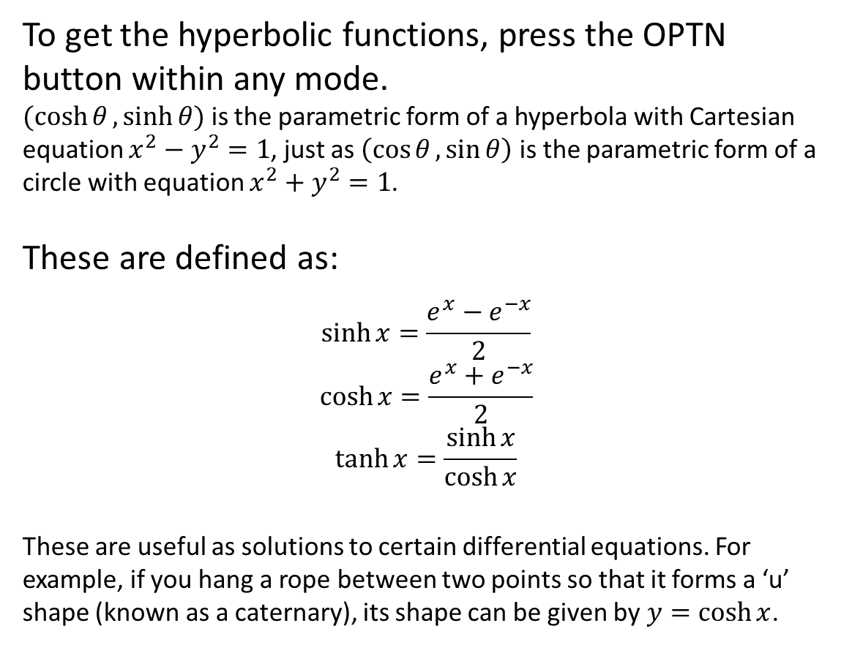
Hyperbolic Functions
< Return
To get the hyperbolic functions, press the OPTN button within any mode.
$(\cosh{θ},\sinh{θ})$ is the parametric form of a hyperbola with Cartesian equation $x^{2}−y^{2}=1$, just as $\left(\cos{θ},\sin{θ}\right)$ is the parametric form of a circle with equation $x^{2}+y^{2}=1$.
These are defined as:
$$\sinh{x}=\frac{e^{x}−e^{−x}}{2}$$
$$\cosh{x}=\frac{e^{x}+e^{−x}}{2}$$
$$\tanh{x}=\frac{\sinh{x}}{\cosh{x}}$$
These are useful as solutions to certain differential equations. For example, if you hang a rope between two points so that it forms a ‘u’ shape (known as a caternary), its shape can be given by $y=\cosh{x}$.

Slide 26

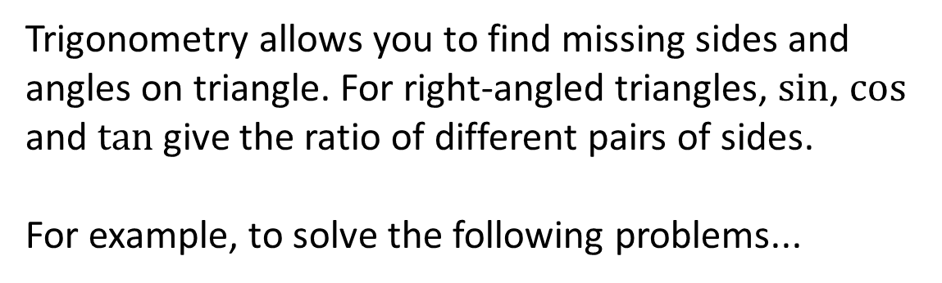
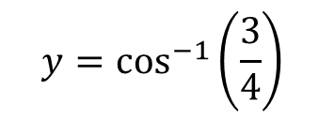


Trigonometric Functions
< Return
sin
Trigonometry allows you to find missing sides and angles on triangle. For right-angled triangles, $sin$, $cos$ and $tan$ give the ratio of different pairs of sides.
For example, to solve the following problems...
cos
tan
sin⁻¹
3
4
$$x$$
$$y$$
60°
3
$$y=\cos^{−1}\left(\frac{3}{4}\right)$$
$$x=3\sin{60}$$

Slide 27
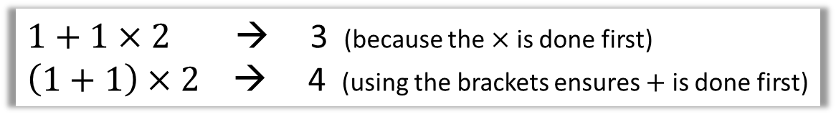
Brackets
< Return
(
Brackets are hugely important in ensuring operations in your expression are evaluated in a certain order. Recall that in ‘BIDMAS’, ‘Brackets’ comes first.
)
$1+1×2$ → 3 (because the $×$ is done first)
$\left(1+1\right)×2$ → 4 (using the brackets ensures $+$ is done first)

Slide 28
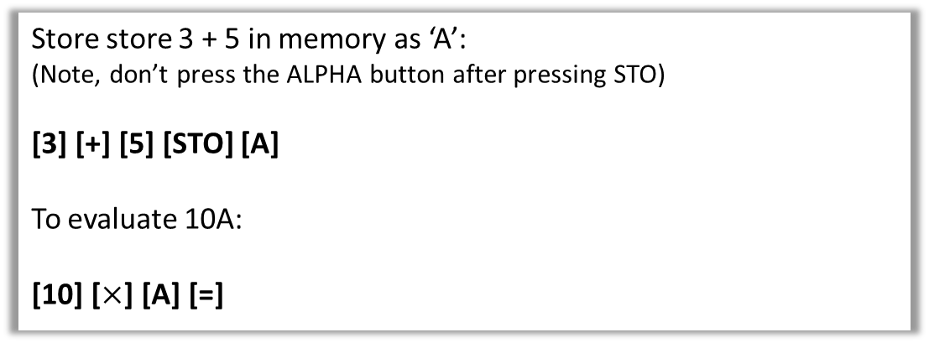
Storing values in variables
< Return
In algebra we use variables to represent values. We can use the letters A, B, C, D, E, F, X, Y on the calculator for this purpose.
STO
Store store 3 + 5 in memory as ‘A’:
(Note, don’t press the ALPHA button after pressing STO)
[3] [+] [5] [STO] [A]
To evaluate 10A:
[10] [$×$] [A] [=]
You may also wish to investigate the ‘CALC’ button.

Slide 29


Engineering Notation
< Return
ENG
Engineering notation is similar to standard form, except the power of 10 can only be a multiple of 3.

Slide 30
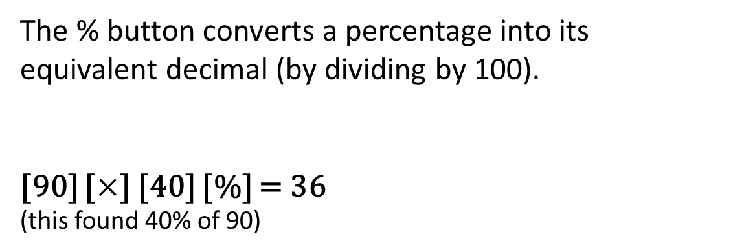
Percentages
< Return
%
The % button converts a percentage into its equivalent decimal (by dividing by 100).
[90] [$×$] [40] [%] = 36
(this found 40% of 90)

Slide 31
Comma
< Return
,
The comma is used for example in generating random integers. Click the RANDINT button for more information.

Slide 32
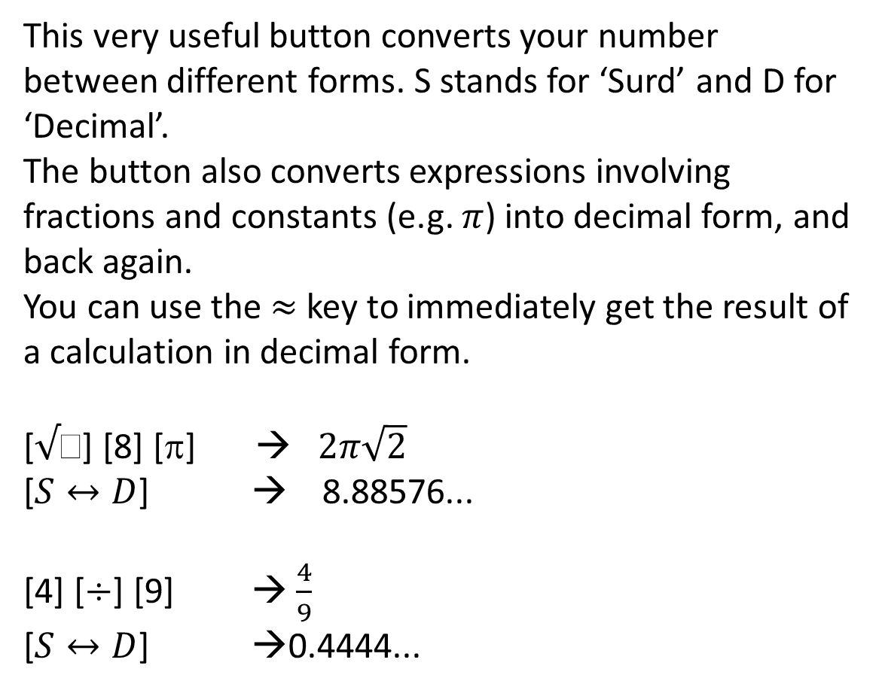

Converting between decimal/surd/fraction
< Return
$$S↔D$$
This very useful button converts your number between different forms. S stands for ‘Surd’ and D for ‘Decimal’.
The button also converts expressions involving fractions and constants (e.g. $π$) into decimal form, and back again.
You can use the $≈$ key to immediately get the result of a calculation in decimal form.
[√] [8] [π] → $2π\sqrt{2}$
[$S↔D$] → 8.88576...
[4] [$÷$] [9] → $\frac{4}{9}$
[$S↔D$] →0.4444...

Slide 33
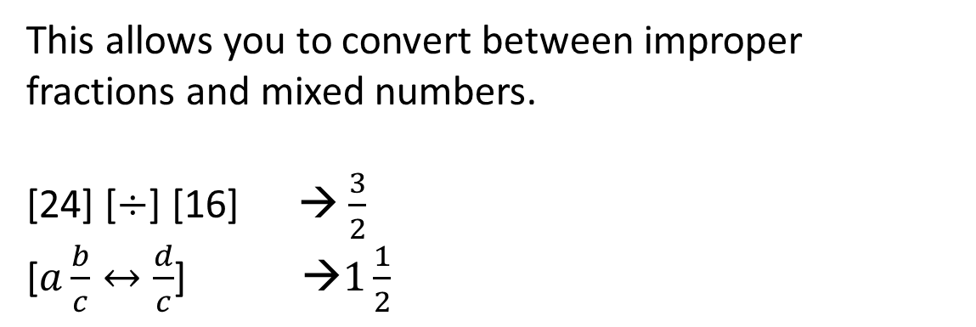
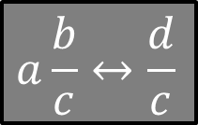
Improper Fractions and Mixed Numbers
< Return
$$a\frac{b}{c}↔\frac{d}{c}$$
This allows you to convert between improper fractions and mixed numbers.
[24] [$÷$] [16] → $\frac{3}{2}$
[$a\frac{b}{c}↔\frac{d}{c}$] →$1\frac{1}{2}$

Slide 34
Independent Memory
< Return
M+
The independent memory is useful if you’re trying to keep a running total of calculations.
Once entering an expression, press [M+] instead of [=] to add your result from the running total.
To subtract the result, use [M-]
To display the currently stored total, use [RCL] [M]
M-
M
(Your value will be preserved when the calculator is turned off.
See the [CLR] button to see how to wipe the value.)

Slide 35
Reset
< Return
RESET
This allows you to delete the values you’ve stored for variables and in independent memory.

Slide 36
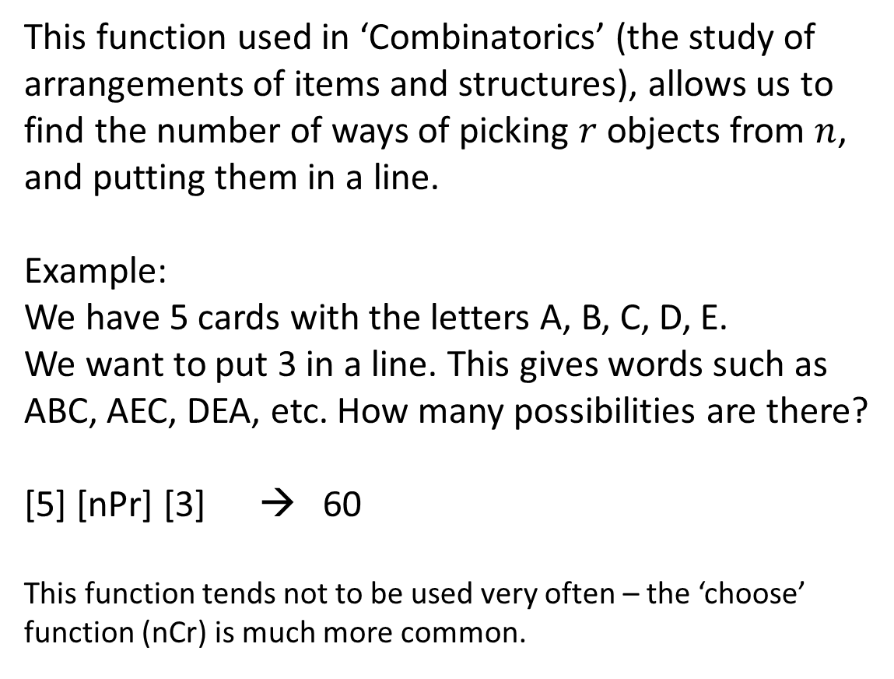
Permutation Function
< Return
nPr
This function used in ‘Combinatorics’ (the study of arrangements of items and structures), allows us to find the number of ways of picking $r$ objects from $n$, and putting them in a line.
Example:
We have 5 cards with the letters A, B, C, D, E.
We want to put 3 in a line. This gives words such as ABC, AEC, DEA, etc. How many possibilities are there?
[5] [nPr] [3] → 60
This function tends not to be used very often – the ‘choose’ function (nCr) is much more common.

Slide 37

Choose Function
< Return
nCr
This function used in ‘Combinatorics’ (the study of arrangements of items and structures), allows us to find the number of ways of choosing $r$ objects from $n$, such that the order of the items doesn’t matter.
Examples:
“How many different possible lottery tickets are there?”
You choose 6 numbers from 49. So:
[49] [nCr] [6] [=] → 13983816

Slide 38
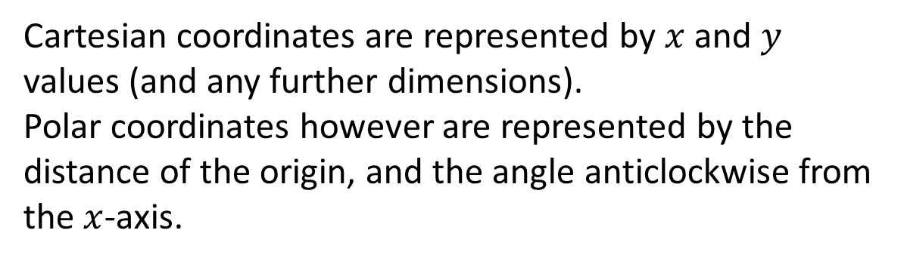
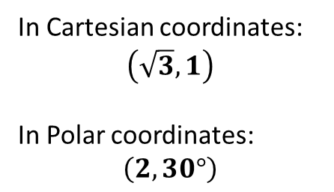


Polar and Rectangular (Catersian) Coords
< Return
Pol
Cartesian coordinates are represented by $x$ and $y$ values (and any further dimensions).
Polar coordinates however are represented by the distance of the origin, and the angle anticlockwise from the $x$-axis.
Rec
$$y$$
In Cartesian coordinates:
$$\left(\sqrt{3},1\right)$$
In Polar coordinates:
$$\left(2,30°\right)$$
(√3,1)
2
30°
To convert Rectangular to Polar:
[POL] [√][3] [,] [1] [=]
To convert Polar to Rectangular:
[REC] [2] [,] [30] [=]
$$x$$

Slide 39
Rounding
< Return
Rnd
Rounds a number according to the current accuracy set on he calculator.

Slide 40
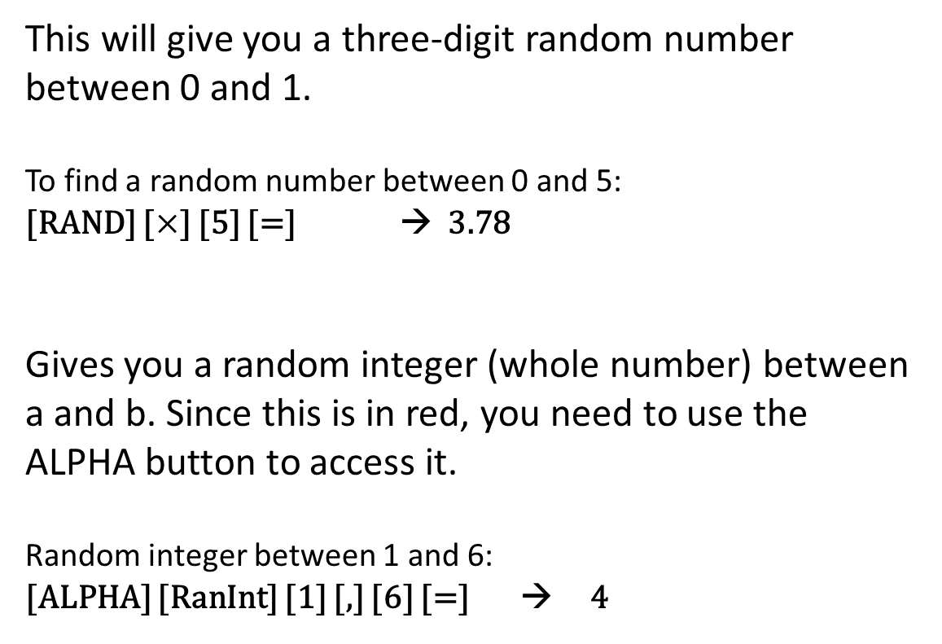

Random Numbers
< Return
RAN#
This will give you a three-digit random number between 0 and 1.
To find a random number between 0 and 5:
[RAND] [$×$] [5] [=] → 3.78
Gives you a random integer (whole number) between a and b. Since this is in red, you need to use the ALPHA button to access it.
Random integer between 1 and 6:
[ALPHA] [RanInt] [1] [,] [6] [=] → 4
RanInt
To get a list of random integers, just put your calculator in TABLE mode, then use the function $f\left(X\right)=RanInt\left(1,10\right)$

Slide 41
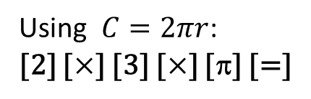
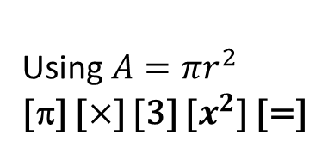
Pi
< Return
π
Pi is typically used in calculations to do with circles.
It is a constant with the value 3.1415...
3
Circumference
Area
Using $A=πr^{2}$
[π] [$×$] [3] [$x^{2}$] [=]
Using $C=2πr$:
[2] [$×$] [3] [$×$] [π] [=]

Slide 42
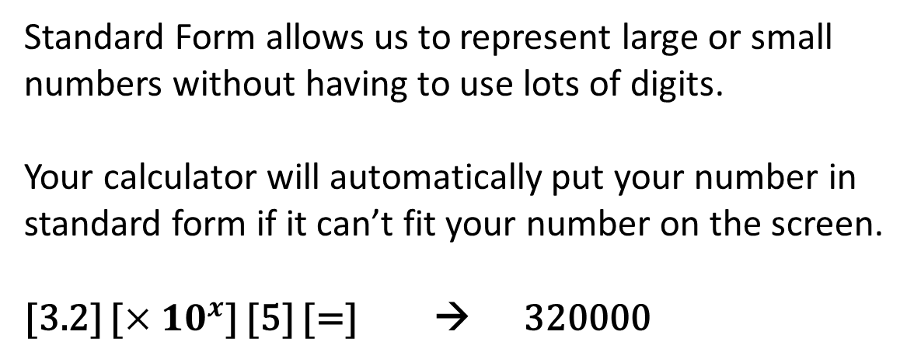
Standard Form
< Return
x10^{x}
Standard Form allows us to represent large or small numbers without having to use lots of digits.
Your calculator will automatically put your number in standard form if it can’t fit your number on the screen.
[3.2] [$×{10}^{x}$] [5] [=] → 320000

Slide 43
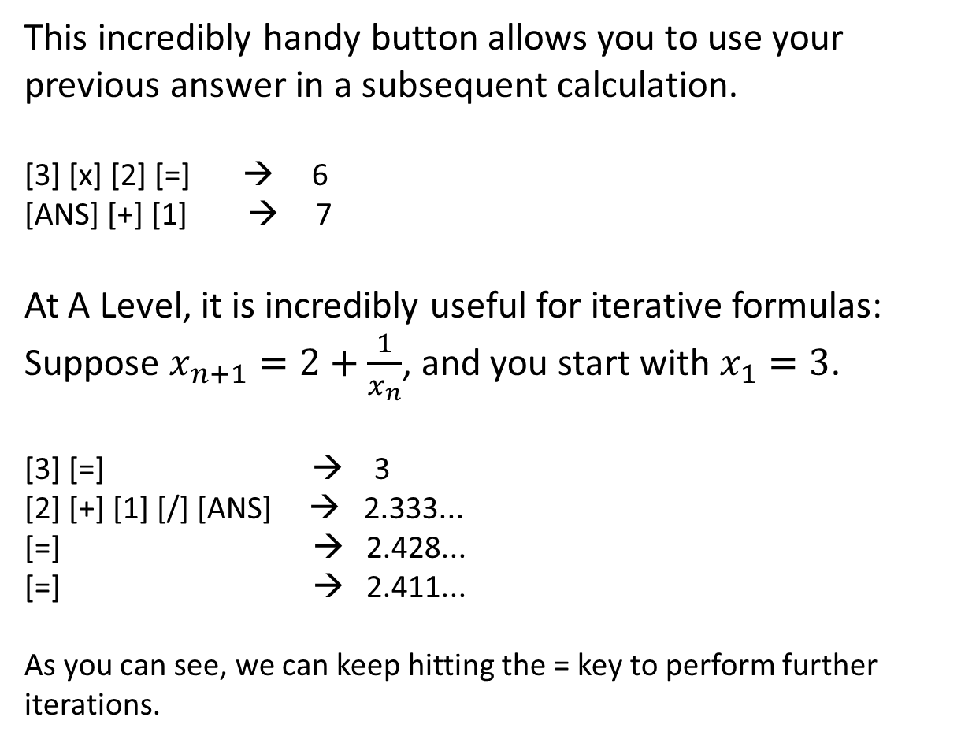
The Answer Button
< Return
ANS
This incredibly handy button allows you to use your previous answer in a subsequent calculation.
[3] [x] [2] [=] → 6
[ANS] [+] [1] → 7
At A Level, it is incredibly useful for iterative formulas:
Suppose $x_{n+1}=2+\frac{1}{x_{n}}$, and you start with $x_{1}=3$.
[3] [=] → 3
[2] [+] [1] [/] [ANS] → 2.333...
[=] → 2.428...
[=] → 2.411...
As you can see, we can keep hitting the = key to perform further iterations.

Slide 44
Secret Menu!
< Return
7
Hold [SHIFT] and [7] and then press [ON].
Now press [9], then [SHIFT] 5 times.
After waiting for the messages to display, press [AC]. You can change the screen contrast, and pressing [AC] again activates a button test – pressing each button (in the correct order!) displays a different integer.

Slide 45
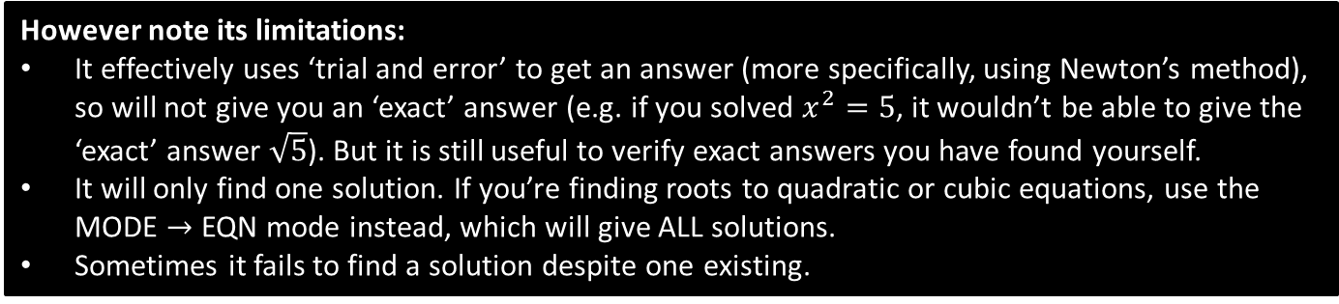
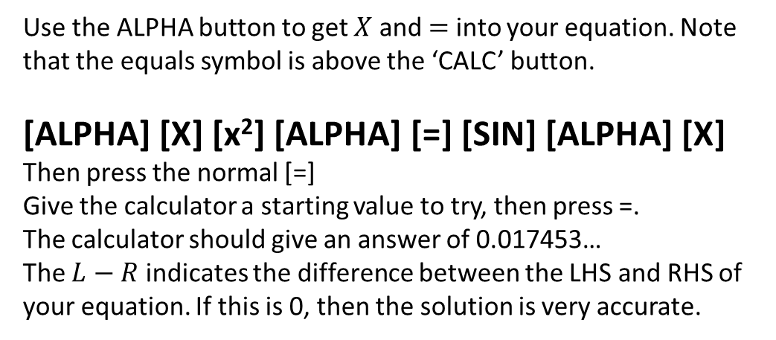

Solving Equations
< Return
SOLVE
Your calculator can solve any equation.
Example: Solve $x^{2}=sin⁡(x)$ when in degrees.
Use the ALPHA button to get $X$ and $=$ into your equation. Note that the equals symbol is above the ‘CALC’ button.
[ALPHA] [X] [x²] [ALPHA] [=] [SIN] [ALPHA] [X]
Then press the normal [=]
Give the calculator a starting value to try, then press =.
The calculator should give an answer of 0.017453…
The $L−R$ indicates the difference between the LHS and RHS of your equation. If this is 0, then the solution is very accurate.
However note its limitations:
It effectively uses ‘trial and error’ to get an answer (more specifically, using Newton’s method), so will not give you an ‘exact’ answer (e.g. if you solved $x^{2}=5$, it wouldn’t be able to give the ‘exact’ answer $\sqrt{5}$). But it is still useful to verify exact answers you have found yourself.
It will only find one solution. If you’re finding roots to quadratic or cubic equations, use the MODE $→$ EQN mode instead, which will give ALL solutions.
Sometimes it fails to find a solution despite one existing.

Slide 46
Easy substitution
< Return
CALC
This allows you to more easily substitute values into an algebraic expression.
Suppose you wanted to evaluate $3a+2b$ when $a=−1$ and $b=2$
Method 1: Store values into variables first.
Method 2: Using CALC button.
[-1] [STO] [A] (stores to A)
[2] [STO] [B]
[3] [ALPHA] [A] + [2] [ALPHA] [B] [=]
Result of 1 given.
[3] [ALPHA] [A] + [2] [ALPHA] [B] [CALC]
Calculator will ask for value of each variable. Press = after entering each.

Slide 47
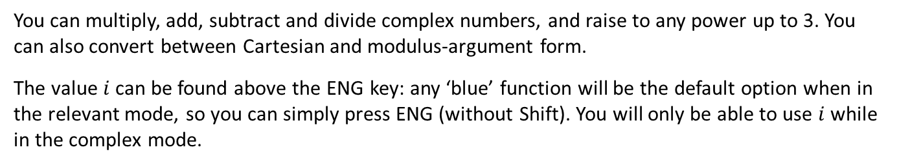
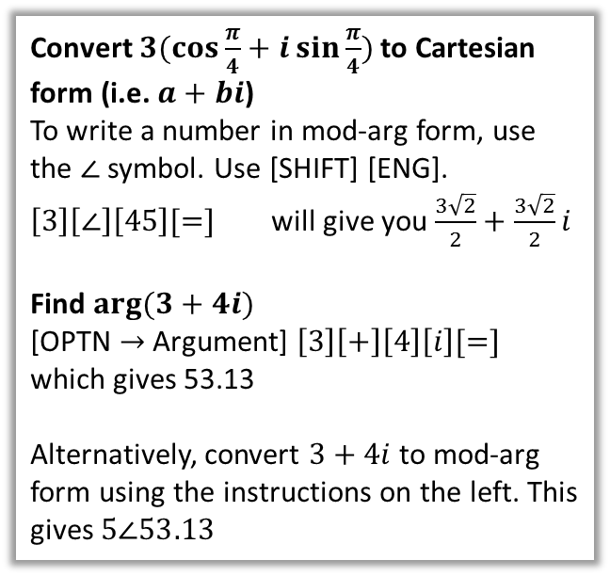
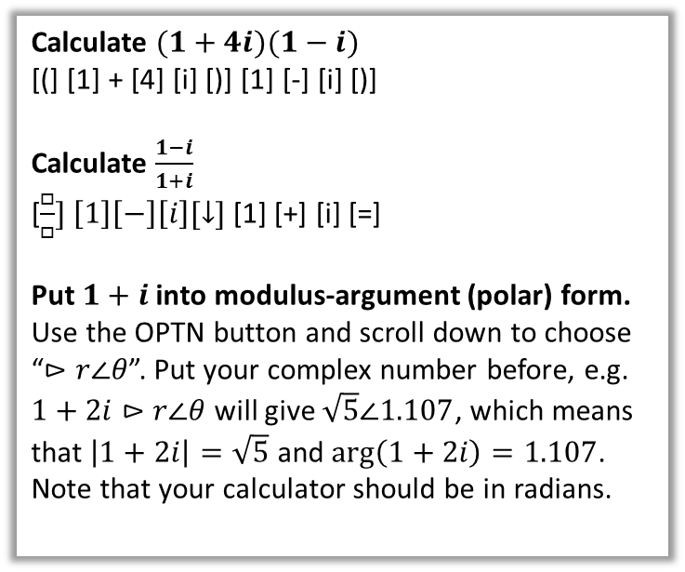
MODE 2: Complex
< Return
You can multiply, add, subtract and divide complex numbers, and raise to any power up to 3. You can also convert between Cartesian and modulus-argument form.
The value $i$ can be found above the ENG key: any ‘blue’ function will be the default option when in the relevant mode, so you can simply press ENG (without Shift). You will only be able to use $i$ while in the complex mode.
Calculate $(1+4i)(1−i)$
[(] [1] + [4] [i] [)] [1] [-] [i] [)]
Calculate $\frac{1−i}{1+i}$
[$\frac{□}{□}] \left[1\right]\left[−\right]\left[i\right][↓]$ [1] [+] [i] [=]
Put $1+i$ into modulus-argument (polar) form.
Use the OPTN button and scroll down to choose
“$⊳r∠θ$”. Put your complex number before, e.g.
$1+2i⊳r∠θ$ will give $\sqrt{5}∠1.107$, which means that $\left|1+2i\right|=\sqrt{5}$ and $\arg\left(1+2i\right)=1.107$. Note that your calculator should be in radians.
Convert $3(cos{\frac{π}{4}+i\sin{\frac{π}{4}}) }$to Cartesian form (i.e. $a+bi$)
To write a number in mod-arg form, use the $∠$ symbol. Use [SHIFT] [ENG].
$\left[3\right]\left[∠\right]\left[45\right][=]$ will give you $\frac{3\sqrt{2}}{2}+\frac{3\sqrt{2}}{2}i$
Find $arg⁡(3+4i)$
[OPTN $→$ Argument] $\left[3\right]\left[+\right]\left[4\right]\left[i\right][=]$
which gives 53.13
Alternatively, convert $3+4i$ to mod-arg form using the instructions on the left. This gives $5∠53.13$

Slide 48
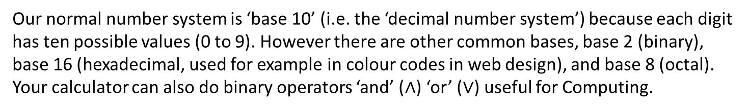
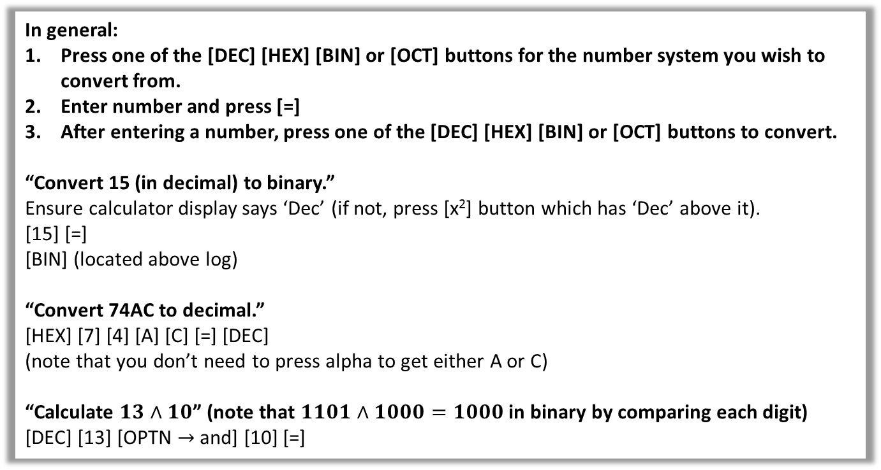
MODE 3: Base-N
< Return
Our normal number system is ‘base 10’ (i.e. the ‘decimal number system’) because each digit has ten possible values (0 to 9). However there are other common bases, base 2 (binary), base 16 (hexadecimal, used for example in colour codes in web design), and base 8 (octal).
Your calculator can also do binary operators ‘and’ ($∧$) ‘or’ ($∨$) useful for Computing.
In general:
Press one of the [DEC] [HEX] [BIN] or [OCT] buttons for the number system you wish to convert from.
Enter number and press [=]
After entering a number, press one of the [DEC] [HEX] [BIN] or [OCT] buttons to convert.
“Convert 15 (in decimal) to binary.”
Ensure calculator display says ‘Dec’ (if not, press [x²] button which has ‘Dec’ above it).
[15] [=]
[BIN] (located above log)
“Convert 74AC to decimal.”
[HEX] [7] [4] [A] [C] [=] [DEC]
(note that you don’t need to press alpha to get either A or C)
“Calculate $13∧10$” (note that $1101∧1000=1000$ in binary by comparing each digit)
[DEC] [13] [OPTN $→$ and] [10] [=]

Slide 49
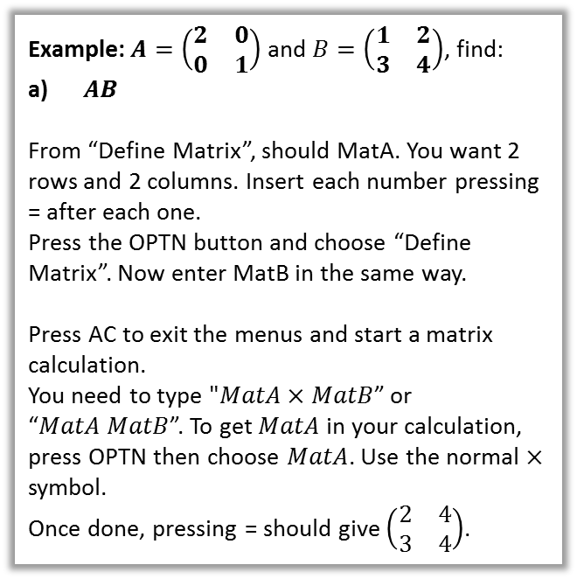
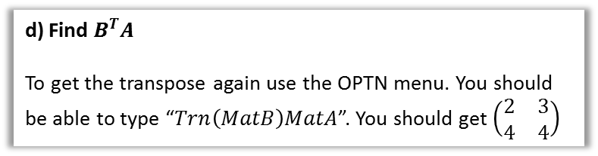
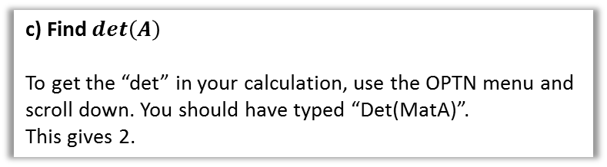

MODE 4: Matrix
< Return
Matrices are rectangular grids of number, intended to represent linear transformations such as rotations about the origin, enlargements about the origin and reflections. You encounter them in Further Maths A level.
Example: $A=\left(\begin{matrix}2 & 0 \\ 0 & 1\end{matrix}\right)$ and $B=\left(\begin{matrix}1 & 2 \\ 3 & 4\end{matrix}\right)$, find:
$AB$
From “Define Matrix”, should MatA. You want 2 rows and 2 columns. Insert each number pressing = after each one.
Press the OPTN button and choose “Define Matrix”. Now enter MatB in the same way.
Press AC to exit the menus and start a matrix calculation.
You need to type "$MatA×MatB$” or “$MatA MatB$”. To get $MatA$ in your calculation, press OPTN then choose $MatA$. Use the normal $×$ symbol.
Once done, pressing = should give $\left(\begin{matrix}2 & 4 \\ 3 & 4\end{matrix}\right)$.
b) Find $A^{−1}$
Press AC again to start a new matrix calculation. You need to type “$MatA^{−1}$”. Get MatA via the OPTN menu again. To get the power of -1, use the $x^{−1}$ key.
This should give you $\left(\begin{matrix}0.5 & 0 \\ 0 & 1\end{matrix}\right)$.
c) Find $det\left(A\right)$
To get the “det” in your calculation, use the OPTN menu and scroll down. You should have typed “Det(MatA)”.
This gives 2.
d) Find $B^{T}A$
To get the transpose again use the OPTN menu. You should be able to type “$Trn\left(MatB\right)MatA$”. You should get $\left(\begin{matrix}2 & 3 \\ 4 & 4\end{matrix}\right)$

Slide 50


MODE 5: Vector
< Return
This is mostly useful for vectors in A Level (Year 2) and Further Maths.
You can find the dot or cross product of two vectors of the angle between them.
Example: If $a=\left(\begin{matrix}4 \\ −1\end{matrix}\right)$ and $b=\left(\begin{matrix}0 \\ 3\end{matrix}\right)$ determine:
$a⋅b$
When you see ‘Define Vector’, choose VctA and choose 2 dimensions. Use = after each of 4 and -1.
Press OPTN then ‘Define Vector’ and input VctB in a similar way.
Press AC to make a calculator.
To write “VctA $⋅$ VctB” use OPTN then VctA to insert the VctA, and OPTN then ‘Dot Product’ (you will need to scroll down) to get the dot.
Once done, pressing = should be -3.
The angle between $a$ and $b$.
Press AC to start a new calculation ($a$ and $b$ will still be stored).
You need to type “Angle(VctA,VctB)” in your calculation. To get “Angle(“, use OPTN then scroll down. For the comma, use the shift key (look above the “)” key). Ensure you close the bracket.
You should get $104.0°$ as your answer.
Example: If $a=\left(\begin{matrix}1 \\ 2 \\ 3\end{matrix}\right)$ and $b=\left(\begin{matrix}3 \\ 2 \\ 1\end{matrix}\right)$
a) determine $a×b$.
Insert $a$ and $b$ in the usual way. If you are already in Vectors mode from the previous example, press OPTN then choose “Define Vector” to update VctA and VctB (note that Edit Vector does not allow you to change the number of dimensions).
Press AC and this time type “$VctA×VctB$”. The $×$ symbol is just a normal $×$.
Pressing = should give $\left(\begin{matrix}−4 \\ 8 \\ −4\end{matrix}\right)$
b) Write your answer as a unit vector.
Press AC then type “UnitV(VctAns)” using the OPTN menu to insert ‘UnitV’ (you need to scroll down). VctAns means the previous answer (similar to the Ans key).
You should get $\left(\begin{matrix}−0.408 \\ 0.8164 \\ −0.408\end{matrix}\right)$

Slide 51







MODE 6: Statistics
< Return
Select a mode:
Single Variable (X)
Use when you have just one variable, e.g. height, weight, shoe size.
Two Variables (X, Y)
Use when you have a scatter diagram, e.g. hours revised against test score.
$$x$$
2
3
5
5
To enter your data, enter each value and press = after each.
If you want a frequency column, press [SHIFT] $→$ [SETUP], scroll down to Statistics, then turn Frequency on. This setting will be saved for future use.
$$x$$ | $$y$$
1 | 3
2 | 6
3 | 5
4 | 8
At A Level, when there are two variables, we measure linear correlation or use linear regression. Thus choose $y=a+bx$.
Enter the left table in a similar manner (if you have a frequency column, the value will default to 1).
Again, while entering data, press OPTN then choose “2-Variable Calc” to obtain a list of all statistics such as $Σx, \overline{x}, Σxy$, etc. or “Regression Calc” to obtain $a, b, r$ (i.e. the coefficients of your line of best fit and the PMCC).
Again, pressing AC allows you to construct a statistical calculation yourself. In OPTN, there is an additional ‘Regression’ menu allowing you to insert $a, b$ and $r$ into your calculation.
While entering data, press OPTN then choose “1-Variable Calc”. This will give you all key statistics ($\overline{x}, Q_{2}, Σx, σ_{x}$, etc.) at the same time.
Press AC to enter calculation mode. From here you can construct a statistic expression yourself, e.g. $Σx/n$. Press OPTN and scroll down to insert symbols such as $Σx$ into your calculation. Summations are found in the ‘Summation’ submenu, $\overline{x}$ and $σ_{x}$ in the ‘Variable’ menu.
You can press OPTN then ‘Data’ to update your table.
While we can use the Distribution mode to get z-values for the normal distribution, we can also do so here. To get for example $P(Z<1)$, press OPTN, scroll down, choose “Norm Dist”, choose $P($, then enter 1 and close the bracket. This will give 0.84134.

Slide 52






MODE 7: Distribution
< Return
This mode allows you get to values associated with common probability distributions such as the Normal Distribution, Binomial Distribution and Poisson Distribution. This is essential for the new A Level, where ‘tables of values’ are no longer provided.
Example: “If $X\sim N\left(100,15^{2}\right)$, find $P\left(X<115\right)$”
Choose “Normal CD” (CD stands for ‘Cumulative Distribution’, as the z-table gives probabilities of being up to a certain value).
You need to specify a range of values for $X$. Note that $X<115$ is the same as $−∞<X<115$.
For ‘Lower’ put an arbitrarily large negative value (say -1000000).
For ‘Upper’ enter 115.
For $σ$ and $μ$ enter 15 and 100.
Press = gives the probability of 0.8413.
Example: “If $X\sim B\left(10,0.1\right)$, find $P\left(X=6\right)$”
Choose “Binomial PD” (PD stands for Probability Density – we wish to find the probability of 6 rather than the probability of ‘up of 6’).
Choose ‘Variable’.
$$x=6 \\ N=10 \\ p=0.1$$
Press = gives 0.000137781.
Example: “If $X\sim N\left(100,15\right)$, find the $x$ such that $P\left(X<x\right)=0.6$
Choose “Normal Inverse”.
$$Area=0.6 \\ σ=15, μ=100$$
Pressing = gives 103.8.
The ‘Area’ means the area under the graph up to your value $x$, the probability of being up to that value.
Note, for working out $P(X<115)$, to avoid the messiness of using -1000000 for the lower bound, you may be better off using the ‘Distr’ function in the Statistics mode.
$$0.6$$
$$x$$

Slide 53

MODE 8: Spreadsheet
< Return
The spreadsheet most is similar to Excel, and you can similarly enter formulas such as Sum, Mean, etc.
Entering numbers:
Use the arrow keys to navigate your spreadsheet, enter a number and press = to put the number in the cell.
Try putting 3 in cell A1, 5 in cell A2, and 10 in A3, as below.
Entering formulae:
Again navigate to a cell, say B1.
Say you wanted to find the mean of cells A1 to A3.
To get this formula, press the OPTN button then scroll down until you see ‘Mean’. Then type A1 (using the ALPHA key to get A), then a colon “:” (again using the ALPHA key), then A3, then close the bracket. It should read:
Mean(A1:A3)
Press = to accept, and in the example on the left, you should get 6 in cell B1.
A1:A3 means “between A1 and A3”
 | A | B
1 | 3 | Mean(A1:A3)
2 | 5
3 | 10
WARNING: If you subsequently change the value of say A1, this will not automatically update B1. To do so, press OPTN, scroll down until you see ‘Recalculate’, and choose this option. The mean of A1 to A3 will then be recalculated.

Slide 54









MODE 9: Table
< Return
A function is simply a ‘number machine’ which takes an input (e.g. $x$) and outputs a value according to some expression, e.g. $f\left(x\right)=x^{2}+\frac{1}{2}$ is a function which squares the input then adds $1/2$.
On a graph, we often make the $y$ value the output of the function, so might write $y=x^{2}+\frac{1}{2}$
In some exam questions you’re asked to calculate a table of values for a given function:
Now input some expression in terms of X. You can use the new $x$ key (top-right) or [ALPHA] → [X] to insert X into your expression.
$$f\left(x\right)=x^{2}+\frac{1}{2}$$
You can also optionally input a second function $g(x)$. Just press = to skip this.
x | -1 | -0.5 | 0 | 0.5
f(x) | 1.5 | 0.75 | 0.5 | 0.75
Once in table mode, your calculator display should look like this:
Enter the starting $x$ value (e.g. -1 on the left table), the ending $x$ value. The step size is what the $x$ values goes up by each time in your table. Press = after each number.
Use the arrow keys to navigate your table.

Slide 55




MODE A: Equation/Func
< Return
While the ‘SOLVE’ button could allow you to solve a quadratic equation, it would only give a single solution and not give an exact answer. The Equation mode however overcomes these problems. It can also find roots when they are complex numbers (involving $i=\sqrt{−1}$).
(Note however it still can’t express roots of cubics or quartics exactly)
Step 1: Select equation vs simultaneous equation solver.
A polynomial is an expression of the form $a+bx+cx^{2}+…$ where the $a,b,c,…$ are constants, for example, $1+2x$ or $3−x+x^{2}+2x^{3}$.
The degree of a polynomial is the highest power, so the degree of a cubic equation, e.g. $x^{3}−2x+1=0$, is 3. So for quadratic equations, use 2.
Simultaneous equations are where you have multiple equations with multiple variables, e.g. $x$ and $y$.
“Solve $x^{3}−x^{2}+3x−4=0$”
Choose polynomial mode, degree 3.
Enter 1, -1, 3, -4, pressing = after each number. Use down arrows to scroll through solutions.
“Solve the simultaneous equations:
$$2x−y=4 \\ 3x+2y=5$$
Choose simultaneous equations, 2 “unknowns” (as we have $x$ and $y$).
Enter 2, -1, 4, 3, 2, 5, pressing = after each number. Use down arrows to scroll through solutions.
Improvements over old Casio models: Solves quartic equations and simultaneous equations with 3 unknowns. The input of coefficients is now clearer as the full (simultaneous) equation(s) are shown before solving.

Slide 56






MODE B: Inequality
< Return
This mode allows you to solve quadratic inequalities, e.g.:
$$x^{2}−2x−3>0$$
but also cubic and quartic inequalities that you find in Further Maths modules:
$$x^{3}−3x^{2}+x−3≤0$$
Step 1: Select the ‘degree’ of your polynomial.
A polynomial is an expression of the form $a+bx+cx^{2}+…$ where the $a,b,c,…$ are constants, for example, $1+2x$ or $3−x+x^{2}+2x^{3}$.
The degree of a polynomial is the highest power, so the degree of a cubic, e.g. $x^{3}−2x+1$, is 3. So for quadratic inequalities, use 2.
Step 2: Select $<$ vs $>$ vs $≤$ vs $≥$
Step 3: Enter your coefficients.
A coefficient is the number/constant in front of each $x$ term. Press = after entering each number.
Your calculator will say “All real numbers” if any number is possible for $x$, or “No real solutions” if there are no solutions for $x$.

Slide 57


MODE C: Ratio
< Return
This mode allows you to find a missing value in two equivalent ratios.
For example, if $2:3=6:x$, the calculator would be able to determine that $x=9$.
Select $A:B=X:D$ or $A:B=C:X$ depending on whether the missing value $X$ is the first number in the ratio or second.

Slide 58

Unit Conversions
< Return
Your calculator can convert between different units.
These are all listed on your calculator case.
Convert 13km/h to m/s
[13] [SHIFT] [CONV]
Choose ‘Velocity’ then $km/h→m/s$
will give 3.6111 m/s

Slide 59


Scientific Constants
< Return
Your calculator has a number of scientific constants, mostly used in Physics.
Exam Warning: The value of $g$ (gravitational acceleration on Earth) is very accurate on your calculator, where Mechanics exams require you to use the less accurate 9.8ms⁻².
Calculate 3g
[3] [SHIFT] [CONST]
Scroll down to ‘Adopted values’ then select $g$.
will give 29.41995

Slide 60


Summation
< Return
You can evaluate expressions of the form $Σ_{x=1}^{n}f\left(x\right)$
For example $\sum_{x=1}^{10}{x^{2}}=1^{2}+2^{2}+…+{10}^{2}$.
Very useful for Further Maths at A Level!
“Determine $Σ_{r=1}^{5}\left(r^{3}−r\right)$”
Press $Σ$ button (using Shift).
Use the directional buttons to move between the parts of the expression.
In order to enter $x^{3}−x$ (note your variable needs to be $x$), use the $x$ key.

Slide 61



Differentiation and Integration
< Return
Note first that your calculator can’t do algebraic differentiation or integration, that is, it wouldn’t be able to determine that $\frac{d}{dx}\left(x^{2}\right)=2x$.
However, it can find the gradient at a particular point on the curve, or do definite integration (i.e. the area under a curve).
“Determine the gradient of $y=x^{3}−\sqrt{x}$ at the point $\left(4,62\right)$”
Press [$\frac{d}{dx}$].
Enter function $X^{3}−\sqrt{X}$ (using the $x$ key to get $x$). Set value of $x$ to 4 using directional arrows. Answer is 47.75.
“Calculate the area under the curve $y=ln x$ between $x=1$ and $x=2$.”
Press [$∫]$ and use arrows to enter $\int_{1}^{2}{\ln\left(X\right)} dx$ (using the $x$ key to get $x$)
Answer is 0.386.
Important note: Your calculator uses the trapezium rule with tiny strips in order to get the answer. It thus does not give exact results. Use only to verify your answer in exams.

