Slide 1

Stats1 Chapter 7 :: Hypothesis Testing
jfrost@tiffin.kingston.sch.uk
www.drfrostmaths.com
@DrFrostMaths
Last modified: 29th November 2017

Slide 2

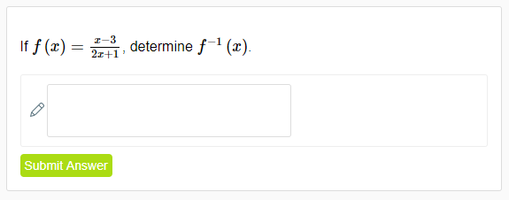
Use of DrFrostMaths for practice
Register for free at:
www.drfrostmaths.com/homework
Practise questions by chapter, including past paper Edexcel questions and extension questions (e.g. MAT).
Teachers: you can create student accounts (or students can register themselves).

Slide 3

Experimental
i.e. Dealing with collected data.
Chp2: Measures of Location/Spread
Chp3: Representation of Data
Chp1: Data Collection
Statistics used to summarise data, including mean, standard deviation, quartiles, percentiles. Use of linear interpolation for estimating medians/quartiles.
Producing and interpreting visual representations of data, including box plots and histograms.
Methods of sampling, types of data, and populations vs samples.
Chp4: Correlation
Measuring how related two variables are, and using linear regression to predict values.
Theoretical
Deal with probabilities and modelling to make inferences about what we ‘expect’ to see or make predictions, often using this to reason about/contrast with experimentally collected data.
Chp5: Probability
Chp6: Statistical Distributions
Chp7: Hypothesis Testing
Venn Diagrams, mutually exclusive + independent events, tree diagrams.
Common distributions used to easily find probabilities under certain modelling conditions, e.g. binomial distribution.
Determining how likely observed data would have happened ‘by chance’, and making subsequent deductions.

Slide 4

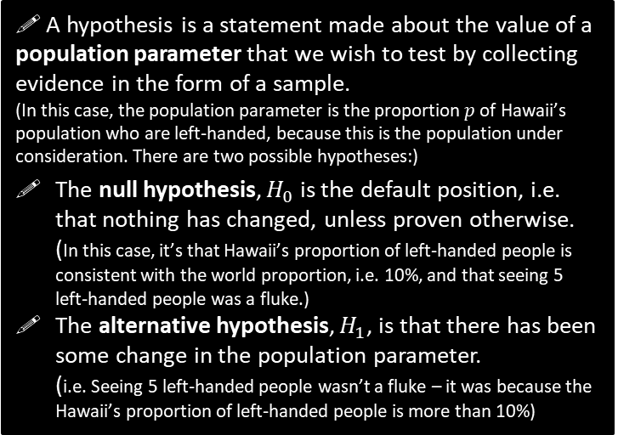
What is Hypothesis Testing?
To get a flavour of hypothesis testing, discuss how you would approach the following problem:
10% of the world’s population are left-handed. On my holiday to Hawaii, I want to establish if the proportion of left-handed people in Hawaii is greater than the world average. I have a table of 20 people as my sample. I need to ensure any result I get is statistically significant.
! A hypothesis is a statement made about the value of a population parameter that we wish to test by collecting evidence in the form of a sample.
(In this case, the population parameter is the proportion $p$ of Hawaii’s population who are left-handed, because this is the population under consideration. There are two possible hypotheses:)
The null hypothesis, $H_{0}$ is the default position, i.e. that nothing has changed, unless proven otherwise.
(In this case, it’s that Hawaii’s proportion of left-handed people is consistent with the world proportion, i.e. 10%, and that seeing 5 left-handed people was a fluke.)
The alternative hypothesis, $H_{1}$, is that there has been some change in the population parameter.
(i.e. Seeing 5 left-handed people wasn’t a fluke – it was because the Hawaii’s proportion of left-handed people is more than 10%)
On the table I count how many are left-handed. Suppose 5 people are.
If I were to assume that 10% of people were left-handed, I calculate (using Binomial distribution) the probability that 5 people (or more) would be left-handed by chance.
If this probability of at least 5 people being left-handed by chance is sufficiently low (say less than 5%), I conclude that that the proportion of Hawaiians who are left-handed is greater than the world proportion.
! In a hypothesis test, the evidence from the sample is a test statistic.
(In this case, we’ve taken a sample by counting let-handed people, and found the test statistic of “number of lefties was 5”)
The level of significance $α$ is the maximum probability where we would reject the null hypothesis.
This is usually 5% or 1%.

Slide 5
What is Hypothesis Testing?
!
Hypothesis testing in a nutshell then is:
We have some hypothesis we wish to see if true (proportion of left-handed people in Hawaii is more than global average), so…
We collect some sample data (giving us our test statistic) and…
If that data is sufficiently unlikely to have emerged ‘just by chance’, then we conclude that our (alternative) hypothesis is correct.

Slide 6
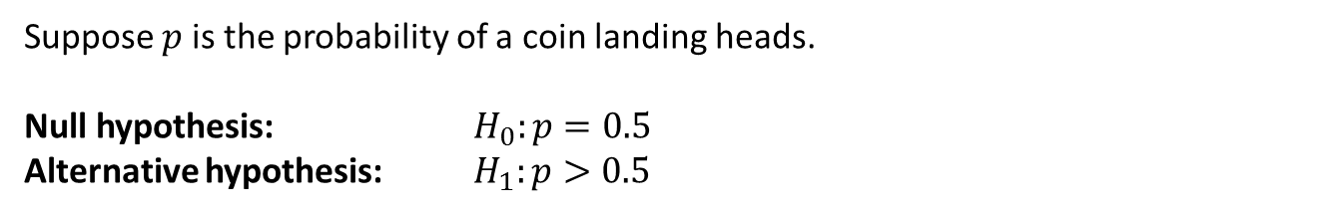
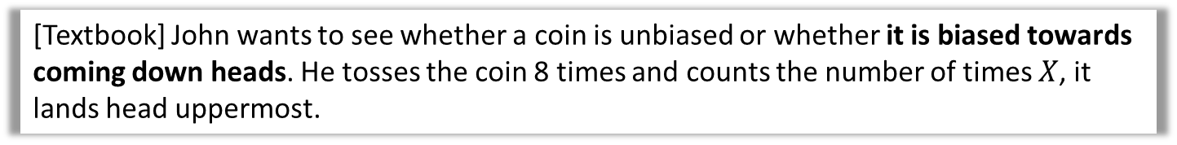
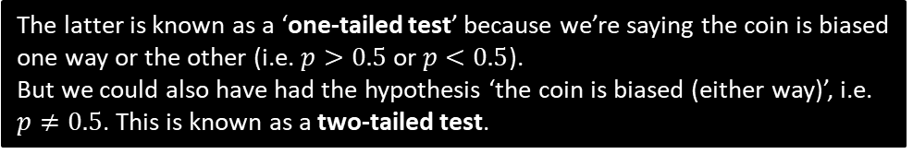
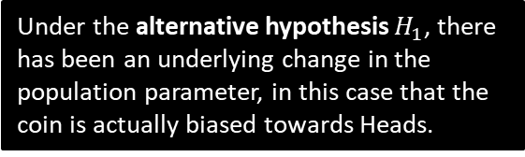
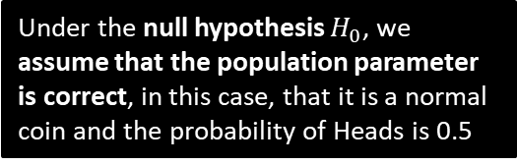
Null Hypothesis and Alternative Hypothesis
[Textbook] John wants to see whether a coin is unbiased or whether it is biased towards coming down heads. He tosses the coin 8 times and counts the number of times $X$, it lands head uppermost.
We said that our two hypotheses are about the population parameter.
Suppose $p$ is the probability of a coin landing heads.
Null hypothesis: $H_{0}:p=0.5$
Alternative hypothesis: $H_{1}:p>0.5$
?
Under the null hypothesis $H_{0}$, we assume that the population parameter is correct, in this case, that it is a normal coin and the probability of Heads is 0.5
?
Under the alternative hypothesis $H_{1}$, there has been an underlying change in the population parameter, in this case that the coin is actually biased towards Heads.
The latter is known as a ‘one-tailed test’ because we’re saying the coin is biased one way or the other (i.e. $p>0.5$ or $p<0.5$).
But we could also have had the hypothesis ‘the coin is biased (either way)’, i.e. $p≠0.5$. This is known as a two-tailed test.

Slide 7
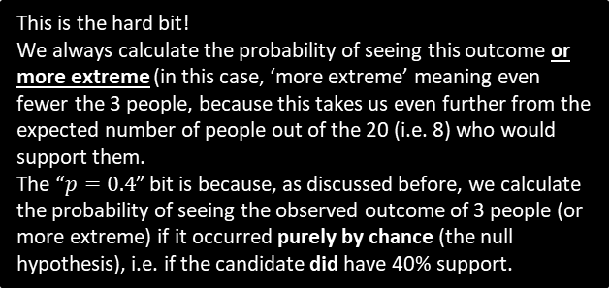

Further Example
[Textbook] An election candidate believes she has the support of 40% of the residents in a particular town. A researcher wants to test, at the 5% significance level, whether the candidate is over-estimating her support. The researcher asks 20 people whether they support the candidate or not. 3 people say they do.
Write down a suitable test statistic.
Write down two suitable hypotheses.
Explain the condition under which the null hypothesis would be rejected.
The number of people who say they support the candidate.
$$H_{0}:p=0.4 \\ H_{1}:p<0.4$$
Null hypothesis would be rejected if the probability of 3 or fewer people supporting the candidate is less than 5%, given that $p=0.4$
For a hypothesis test involving the binomial distribution, the test statistic is always the count of successes.
a
?
The alternative hypothesis is that the candidate is overestimating her support, so we’re interested where less than 40% support them (more than 40% would not undermine the candidate’s claim).
b
?
c
?
This is the hard bit!
We always calculate the probability of seeing this outcome or more extreme (in this case, ‘more extreme’ meaning even fewer the 3 people, because this takes us even further from the expected number of people out of the 20 (i.e. 8) who would support them.
The “$p=0.4$” bit is because, as discussed before, we calculate the probability of seeing the observed outcome of 3 people (or more extreme) if it occurred purely by chance (the null hypothesis), i.e. if the candidate did have 40% support.

Slide 8
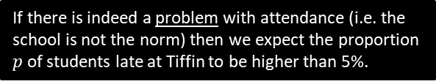

Test Your Understanding
In the UK, 5% of students turn up late to school each day. Mr Hameed wishes to determine, to a 10% significance level if his school, Piffin School, has a problem with attendance. He stands at the front gate one day and finds that 6 of the 40 students who pass him are late.
Write down a suitable test statistic.
Write down two suitable hypotheses.
Explain the condition under which the null hypothesis would be rejected.
a
The number of students who are late to school that day.
$$H_{0}:p=0.05 \\ H_{1}:p>0.05$$
Null hypothesis would be rejected if the probability of 6 or more students being late to school is less than 10%, given that $p=0.05$
?
If there is indeed a problem with attendance (i.e. the school is not the norm) then we expect the proportion $p$ of students late at Tiffin to be higher than 5%.
b
?
c
?
Just to reiterate again what’s going on here:
We assume that the school is the norm (i.e. 5% of students are late), and calculate the probability that 6 or more students would be late under this assumption.
If the probability of this happening by chance is sufficiently unlikely (less than the 10% significance level), we conclude that it probably isn’t just by chance, and the school’s lateness rate is worse than 5%.

Slide 9
Exercise 7A
Pearson Pure Mathematics Year 1/AS
Pages 100-101

Slide 10

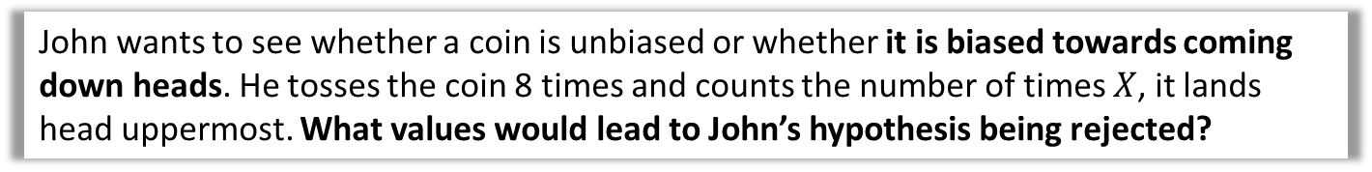
Critical Regions and Values
John wants to see whether a coin is unbiased or whether it is biased towards coming down heads. He tosses the coin 8 times and counts the number of times $X$, it lands head uppermost. What values would lead to John’s hypothesis being rejected?
As before, we’re interested how likely a given outcome is likely to happen ‘just by chance’ under the null hypothesis (i.e. when the coin is not biased).
However, there are values which collectively form a range of ‘extreme values’ where it would be unlikely that the coin would be unbiased. Their combined probability is limited by the level of significance set (e.g. 5%)
The probability of getting exactly 5 heads is only 22%, which is more likely to not happen than to happen. If we saw this number of heads, why would it not be sensible to think the coin is biased?
The probability is only low because there’s lots of possible outcomes. But 5 heads forms part of a range of possible number of heads that collectively would be consistent with a coin not biased towards heads.
?
Prob under $H_{0}$
0 1 2 3 4 5 6 7 8
Num heads

Slide 11

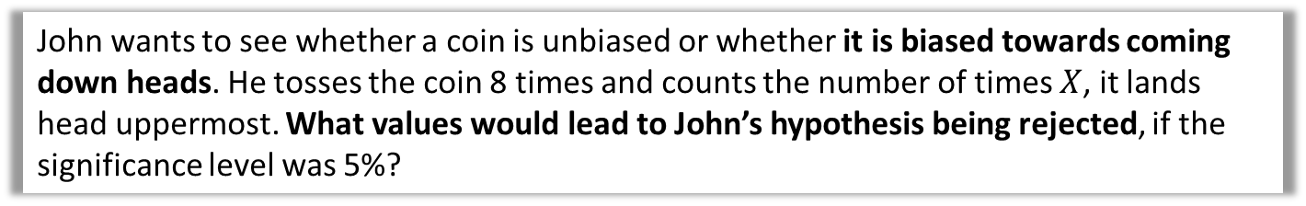
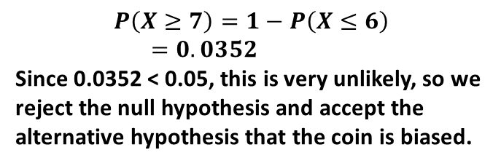
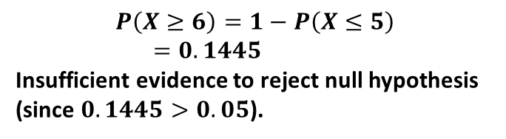
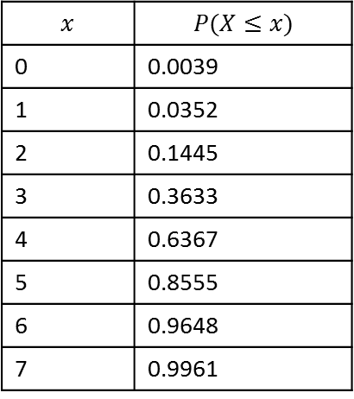
Critical Regions and Values
John wants to see whether a coin is unbiased or whether it is biased towards coming down heads. He tosses the coin 8 times and counts the number of times $X$, it lands head uppermost. What values would lead to John’s hypothesis being rejected, if the significance level was 5%?
What’s the probability that we would see 6 heads, or an even more extreme value? Is this sufficiently unlikely to support John’s claim that the coin is biased?
C.D.F. Binomial table:
$$p=0.5, n=8$$
$$x$$ | $$P(X≤x)$$
0 | 0.0039
1 | 0.0352
2 | 0.1445
3 | 0.3633
4 | 0.6367
5 | 0.8555
6 | 0.9648
7 | 0.9961
$$P\left(X≥6\right)=1−P\left(X≤5\right) \\ =0.1445$$
Insufficient evidence to reject null hypothesis (since $0.1445>0.05$).
?
What’s the probability that we would see 7 heads, or an even more extreme value?
?
$$P\left(X≥7\right)=1−P\left(X≤6\right) \\ =0.0352$$
Since 0.0352 < 0.05, this is very unlikely, so we reject the null hypothesis and accept the alternative hypothesis that the coin is biased.

Slide 12
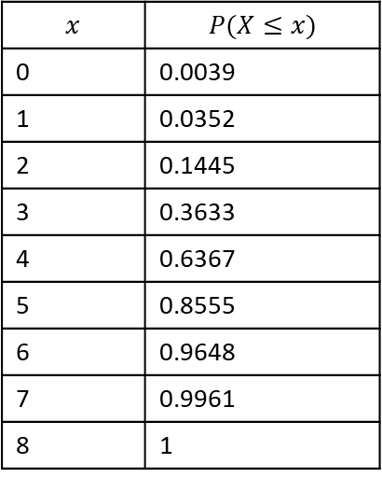
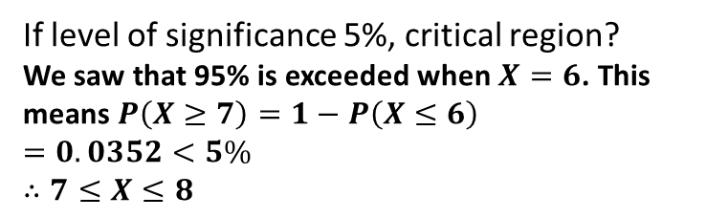
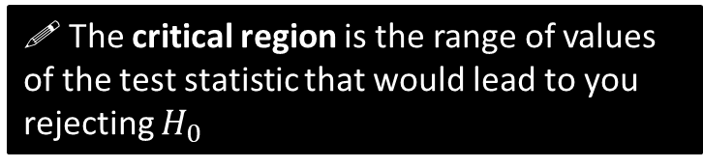

Critical Regions and Values
John wants to see whether a coin is unbiased or whether it is biased towards coming down heads. He tosses the coin 8 times and counts the number of times $X$, it lands head uppermost. What values would lead to John’s hypothesis being rejected, if the significance level was 5%?
! The critical region is the range of values of the test statistic that would lead to you rejecting $H_{0}$
C.D.F. Binomial table:
$$p=0.5, n=8$$
?
$$x$$ | $$P(X≤x)$$
0 | 0.0039
1 | 0.0352
2 | 0.1445
3 | 0.3633
4 | 0.6367
5 | 0.8555
6 | 0.9648
7 | 0.9961
8 | 1
If level of significance 5%, critical region?
We saw that 95% is exceeded when $X=6$. This means $P\left(X≥7\right)=1−P\left(X≤6\right)$
$=0.0352<5\%$
$$∴7≤X≤8$$
Fro Tip: Use the first value AFTER the one in the table that exceeds 95%.
! The value(s) on the boundary of the critical region are called critical value(s).
Critical value:
$$7$$
?

Slide 13

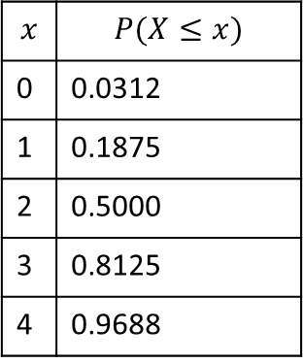

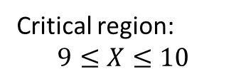

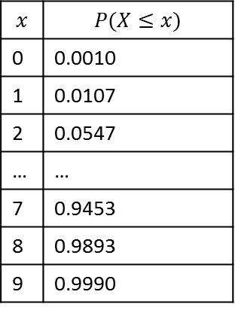
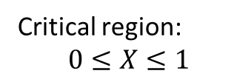
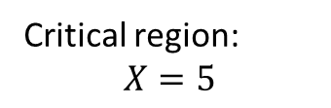
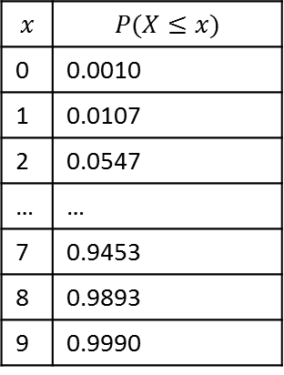
Quickfire Critical Regions
Determine the critical region when we throw a coin where we’re trying to establish if there’s the specified bias, given the specified number of throws, when the level of significance is 5%.
Coin thrown 5 times. Trying to establish if biased towards heads.
Coin thrown 10 times. Trying to establish if biased towards heads.
Coin thrown 10 times. Trying to establish if biased towards tails.
Fro Reminder: At the positive tail, use the value AFTER the first that exceeds 95% (100 - 5).
$$p=0.5, n=5$$
$$p=0.5, n=10$$
$$p=0.5, n=10$$
$$x$$ | $$P(X≤x)$$
0 | 0.0312
1 | 0.1875
2 | 0.5000
3 | 0.8125
4 | 0.9688
$$x$$ | $$P(X≤x)$$
0 | 0.0010
1 | 0.0107
2 | 0.0547
… | …
7 | 0.9453
8 | 0.9893
9 | 0.9990
$$x$$ | $$P(X≤x)$$
0 | 0.0010
1 | 0.0107
2 | 0.0547
… | …
7 | 0.9453
8 | 0.9893
9 | 0.9990
At the negative tail, we just use the first value that goes under the significance level.
Critical region:
$$X=5$$
Critical region:
$$9≤X≤10$$
Critical region:
$$0≤X≤1$$
?
?
?

Slide 14

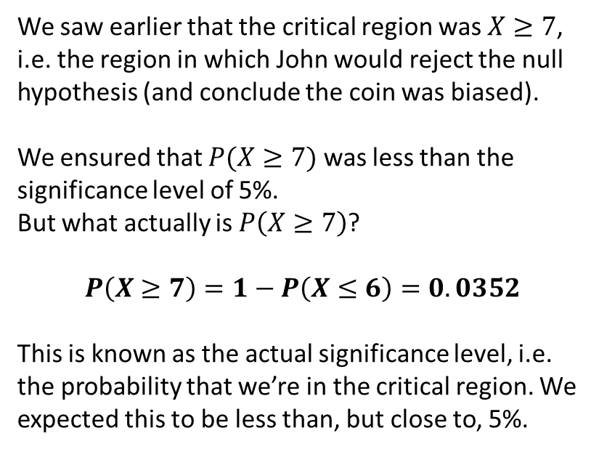
Actual Significance Level
John wants to see whether a coin is unbiased or whether it is biased towards coming down heads. He tosses the coin 8 times and counts the number of times $X$, it lands head uppermost. What values would lead to John’s hypothesis being rejected, if the significance level was 5%?
We saw earlier that the critical region was $X≥7$, i.e. the region in which John would reject the null hypothesis (and conclude the coin was biased).
We ensured that $P(X≥7)$ was less than the significance level of 5%.
But what actually is $P\left(X≥7\right)$?
$$P\left(X≥7\right)=1−P\left(X≤6\right)=0.0352$$
This is known as the actual significance level, i.e. the probability that we’re in the critical region. We expected this to be less than, but close to, 5%.
C.D.F. Binomial table:
$$p=0.5, n=8$$
$$x$$ | $$P(X≤x)$$
0 | 0.0039
1 | 0.0352
2 | 0.1445
3 | 0.3633
4 | 0.6367
5 | 0.8555
6 | 0.9648
7 | 0.9961
8 | 1
?
! The actual significance level is the actual probability of being in the critical region.

Slide 15



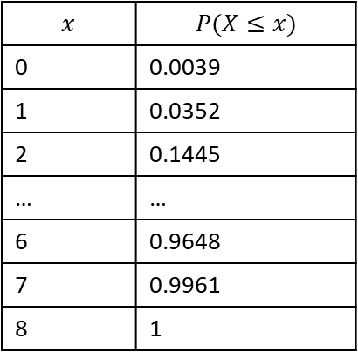
Two-tailed test
Critical region
Acceptance region
Critical region
Suppose I threw a coin 8 times and was now interested in how may heads would suggest it was a biased coin (i.e. either way!). How do we work out the critical values now, with 5% significance?
We split the 5% so there’s 2.5% at either tail, then proceed as normal:
Prob under $H_{0}$
?
0 1 2 3 4 5 6 7 8
Num heads
C.D.F. Binomial table:
$$p=0.5, n=8$$
Critical region at positive tail:
Look at closest value above 0.975 (then go one above):
$$X=8$$
Critical region at negative tail:
Look at closest value below 0.025.
$$X=0$$
?
$$x$$ | $$P(X≤x)$$
0 | 0.0039
1 | 0.0352
2 | 0.1445
… | …
6 | 0.9648
7 | 0.9961
8 | 1
?

Slide 16
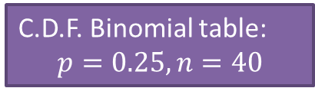

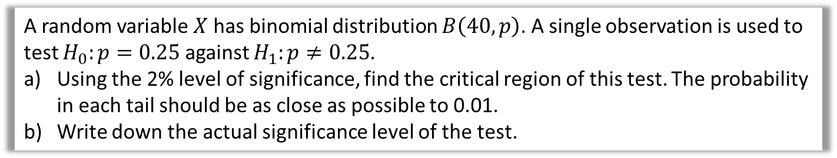


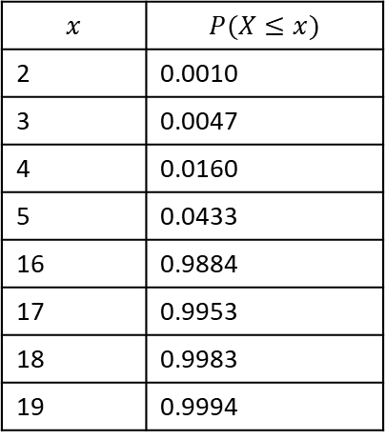
Test Your Understanding
A random variable $X$ has binomial distribution $B\left(40,p\right)$. A single observation is used to test $H_{0}:p=0.25$ against $H_{1}:p≠0.25$.
Using the 2% level of significance, find the critical region of this test. The probability in each tail should be as close as possible to 0.01.
Write down the actual significance level of the test.
The $≠$ indicates bias either way, i.e. two-tailed.
This means you find the closest to 0.01 (even if slightly above) rather than the closest under 0.01
a
?
To ensure all method marks always show the probability of being in the critical region (even if you don’t subsequently need the value!)
(Half of 0.02 is 0.01)
$$P\left(X≤3\right)=0.0047$$
$$0≤X≤3$$
$$P\left(X≥17\right)=1−P\left(X≤16\right)=0.0116$$
$$17≤X≤40$$
Critical region is $0≤X≤3$ or $17≤X≤40$
$$0.0047+0.0116=0.0163=1.63\%$$
C.D.F. Binomial table:
$$p=0.25, n=40$$
$$x$$ | $$P(X≤x)$$
2 | 0.0010
3 | 0.0047
4 | 0.0160
5 | 0.0433
16 | 0.9884
17 | 0.9953
18 | 0.9983
19 | 0.9994
Note that $X$ can’t go below 0 or exceed 40.
b
?
Warning: Textbook has several typos in this example.

Slide 17
Exercise 7B
Pearson Pure Mathematics Year 1/AS
Pages 103-105

Slide 18
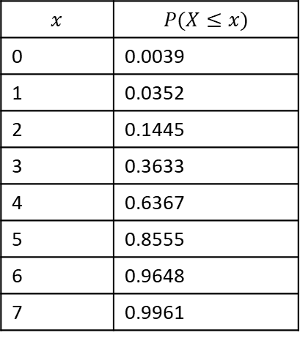
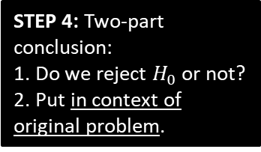

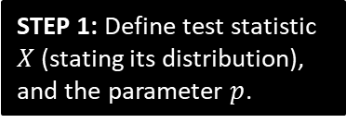


Doing a full one-tailed hypothesis test
We’ve done various bits of a hypothesis test, and haven’t actually properly conducted one yet. Let’s do an example!
John tosses a coin 8 times and it comes up heads 6 times. He claims the coin is biased towards heads. With a significance level of 5%, test his claim.
?
$X$ is number of heads.
$p$ is probability of heads.
$$X\sim B\left(8,p\right)$$
$$H_{0}:p=0.5 \\ H_{1}:p>0.5$$
STEP 1: Define test statistic $X$ (stating its distribution), and the parameter $p$.
C.D.F. Binomial table:
$$p=0.5, n=8$$
STEP 2: Write null and alternative hypotheses.
$$x$$ | $$P(X≤x)$$
0 | 0.0039
1 | 0.0352
2 | 0.1445
3 | 0.3633
4 | 0.6367
5 | 0.8555
6 | 0.9648
7 | 0.9961
?
Assume $H_{0}$ is true, $X\sim B\left(8,0.5\right)$
$$P\left(X≥6\right)=1−P\left(X≤5\right) \\ =1−0.8555 \\ =0.1445$$
14.45% > 5%, so insufficient evidence to reject $H_{0}$.
Coin is not biased.
STEP 3: Determine probability of observed test statistic (or ‘more extreme’), assuming null hypothesis.
i.e. Determine probability we’d see this outcome just by chance.
?
?
STEP 4: Two-part conclusion:
1. Do we reject $H_{0}$ or not?
2. Put in context of original problem.

Slide 19
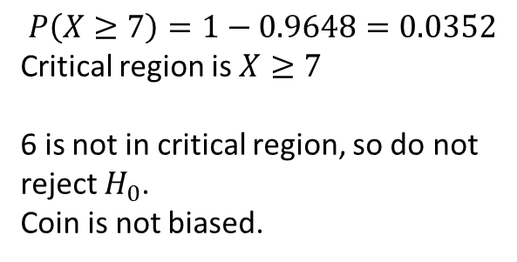
Alternative method using critical regions
We can also find the critical region and see if the test statistic lies within it.
John tosses a coin 8 times and it comes up heads 6 times. He claims the coin is biased towards heads. With a significance level of 5%, test his claim.
$X$ is number of heads.
$p$ is probability of heads.
$$X\sim B\left(8,p\right)$$
$$H_{0}:p=0.5 \\ H_{1}:p>0.5$$
STEP 1: Define test statistic $X$ (stating its distribution), and the parameter $p$.
C.D.F. Binomial table:
$$p=0.5, n=8$$
STEP 2: Write null and alternative hypotheses.
$$x$$ | $$P(X≤x)$$
0 | 0.0039
1 | 0.0352
2 | 0.1445
3 | 0.3633
4 | 0.6367
5 | 0.8555
6 | 0.9648
7 | 0.9961
$$P\left(X≥7\right)=1−0.9648=0.0352$$
Critical region is $X≥7$
6 is not in critical region, so do not reject $H_{0}$.
Coin is not biased.
?
STEP 3 (Alternative): Determine critical region.
?
STEP 4: Two-part conclusion:
1. Do we reject $H_{0}$ or not?
2. Put in context of original problem.

Slide 20


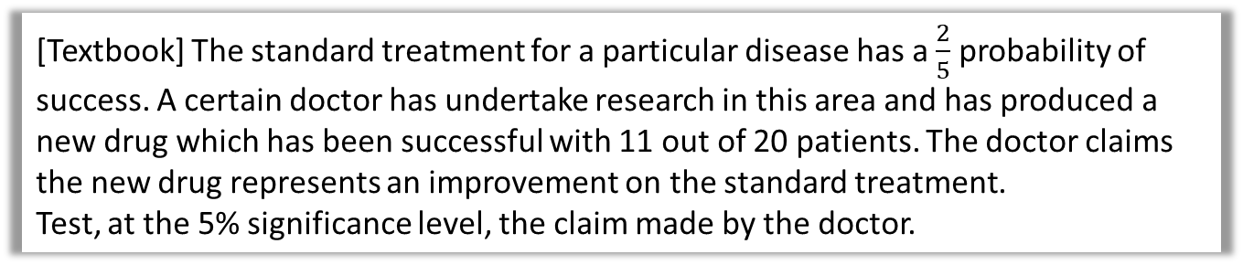


Further Example
[Textbook] The standard treatment for a particular disease has a $\frac{2}{5}$ probability of success. A certain doctor has undertake research in this area and has produced a new drug which has been successful with 11 out of 20 patients. The doctor claims the new drug represents an improvement on the standard treatment.
Test, at the 5% significance level, the claim made by the doctor.
?
$X$ is number of patients for whom trial was successful.
$p$ is probability of success in each patient.
$$X\sim B\left(20,p\right)$$
$$H_{0}:p=0.4 \\ H_{1}:p>0.4$$
Assume $H_{0}$ is true, so $X\sim B(20,0.4)$
$$P\left(X≥11\right)=1−P\left(X≤10\right)=0.1275$$
12.75% > 5% so not enough evidence to reject $H_{0}$.
$∴$ New drug is no better than old one.
STEP 1: Define test statistic $X$ (stating its distribution), and the parameter $p$.
?
STEP 2: Write null and alternative hypotheses.
?
STEP 3: Determine probability of observed test statistic (or ‘more extreme’), assuming null hypothesis.
?
STEP 4: Two-part conclusion:
1. Do we reject $H_{0}$ or not?
2. Put in context of original problem.

Slide 21
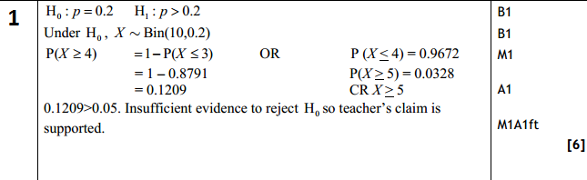

Test Your Understanding
Edexcel S2 Jan 2011 Q2
A student takes a multiple choice test. The test is made up of 10 questions each with 5 possible answers. The student gets 4 questions correct. Her teacher claims she was guessing the answers. Using a one tailed test, at the 5% level of significance, test whether or not there is evidence to reject the teacher’s claim.
State your hypotheses clearly. (6)
?
Note the mark for stating distribution of $X$ under null hypothesis.
Note two-mark conclusion.

Slide 22
Exercise 7C
Pearson Pure Mathematics Year 1/AS
Pages 106-107

Slide 23

Two-Tailed Tests
We have already seen that if we’re interest in bias ‘either way’, we have two tails, and therefore have to split the critical region by halving the significance level at each end.
Over a long period of time it has been found that in Enrico’s restaurant the ratio of non-veg to veg meals is 2 to 1. In Manuel’s restaurant in a random sample of 10 people ordering meals, 1 ordered a vegetarian meal. Using a 5% level of significance, test whether or not the proportion of people eating veg meals in Manuel’s restaurant is different to that in Enrico’s restaurant.
?
Proportion eating veg meals at Enrico’s is $\frac{1}{3}$
Let $p$ be the proportion of people at Manuel’s that order veg.
Let $X$ be number of people eating veg meals.
$$H_{0}:p=\frac{1}{3} H_{1}:p≠\frac{1}{3}$$
If $H_{0}$ true then $X\sim B\left(10,\frac{1}{3}\right)$
$$P\left(X≤1\right)=P\left(X=0\right)+P\left(X=1\right) \\ =0.104 (3sf)$$
$0.104>0.025$ therefore insufficient evidence to reject $H_{0}$.
There is no evidence that proportion of veg meals at Manuel’s restaurant is different to Enrico’s.
Half significance as 2 tailed.
Conclusion and what it means in context.

Slide 24
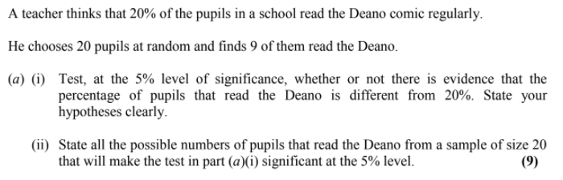
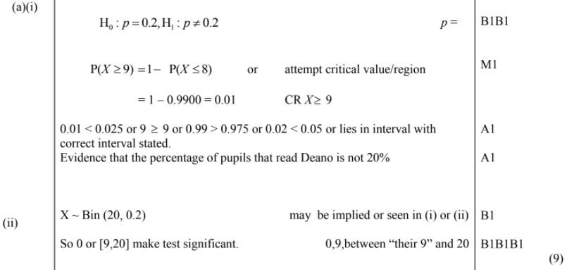
Test Your Understanding
Edexcel S2 Jan 2006 Q7a
?
?

Slide 25
Exercise 7D
Pearson Pure Mathematics Year 1/AS
Pages 108-109

