Slide 1

MechYr2 Chapter 4 :: Moments
jfrost@tiffin.kingston.sch.uk
www.drfrostmaths.com @DrFrostMaths
Last modified: 30th July 2018

Slide 2




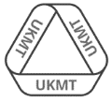
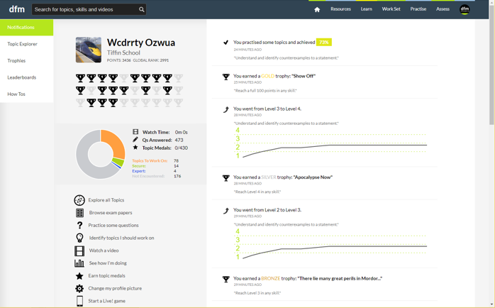
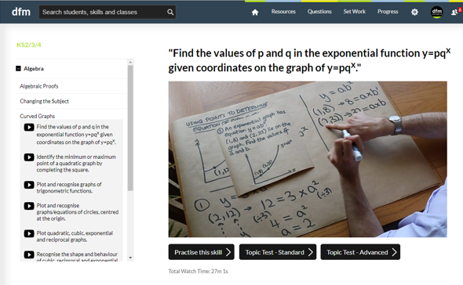
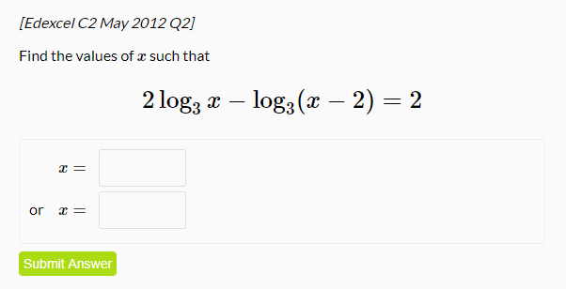
www.drfrostmaths.com
Everything is completely free.
Why not register?
Register now to interactively practise questions on this topic, including past paper questions and extension questions (including MAT + UKMT).
Teachers: you can create student accounts (or students can register themselves), to set work, monitor progress and even create worksheets.
With questions by:
Dashboard with points, trophies, notifications and student progress.
Questions organised by topic, difficulty and past paper.
Teaching videos with topic tests to check understanding.

Slide 3

Motivating problem
This… is a door.
Why do you think the handle is put on the other side of the door from the hinge?
Increasing the distance of the force applied from the point of rotation increases the ‘turning effect’ of the force.
If I double the distance of my finger from the hinge, what happens to the force required to keep the door open?
As the distance doubles, the force required halves (we’ll see why).
?
?

Slide 4




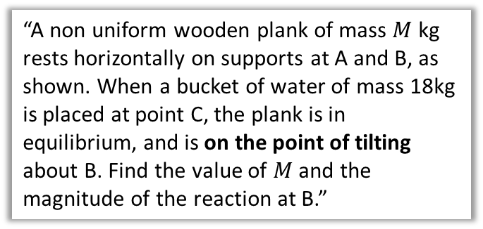




Rigid Bodies and Overview
$$R$$
$$T$$
We previously dealt with particles, where each object was modelled just as a single point, and considered forces acting on each point separately.
Body rotating about pivot.
$$mg$$
$$mg$$
In this chapter we consider rigid bodies (in this case rods), which takes into account the size of the object.
This means we can consider other properties, e.g. rotation of the body.
1:: Moments in equilibrium
Clockwise moment = Anticlockwise moment
2:: Centre of Mass
3:: On the point of Tilting
For a ‘non-uniform’ rod we can’t model its weight as acting at the centre.
“A non uniform wooden plank of mass $M$ kg rests horizontally on supports at A and B, as shown. When a bucket of water of mass 18kg is placed at point C, the plank is in equilibrium, and is on the point of tilting about B. Find the value of $M$ and the magnitude of the reaction at B.”
$$R_{1}$$
$$R_{2}$$
$x$?
$$mg$$

Slide 5



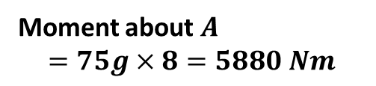
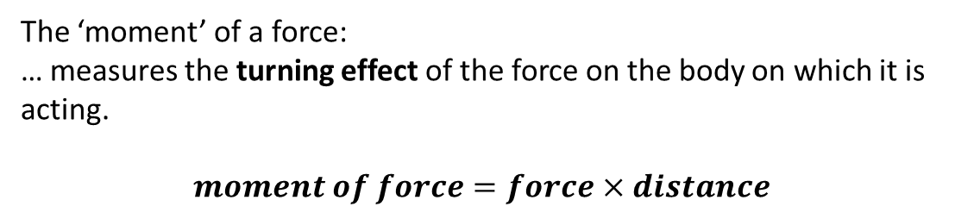

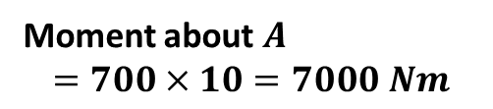
Moments
!
The ‘moment’ of a force:
… measures the turning effect of the force on the body on which it is acting.
$$moment of force=force×distance$$
?
about a point
perpendicular distance
(Disclaimer: ex-Tiffinians featured with their permission, and much to their delight)
Notice that the measured distance is perpendicular to the force being considered.
Tom has a mass of 75kg.
10m
8m
$$A$$
?
700 N
$$75g$$
Moment about $A$
$$=700×10=7000 Nm$$
Moment about $A$
$$=75g×8=5880 Nm$$
?
?
The anticlockwise moment is greater, so the seesaw will tilt in an anticlockwise direction.

Slide 6


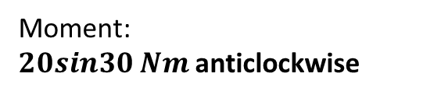



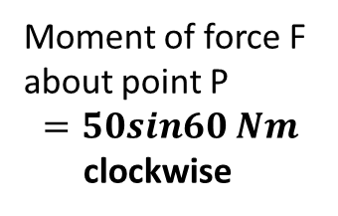

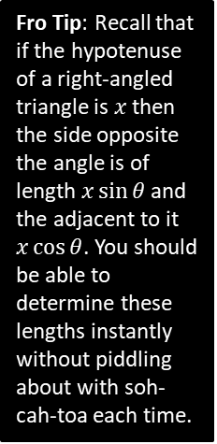






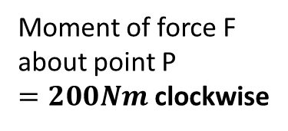

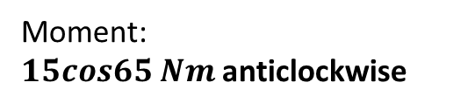






Quickfire Examples
1
$$F=20N$$
2
3
$$10N$$
$$F=20N$$
$$10m$$
$$5m$$
$$60°$$
We see what force is acting perpendicularly.
$$P$$
$$P$$
$$5sin60$$
$$P$$
Moment of force F about point P
$$=50sin60 Nm$$
clockwise
Fro Tip: Recall that if the hypotenuse of a right-angled triangle is $x$ then the side opposite the angle is of length $x\sin{θ}$ and the adjacent to it $x\cos{θ}$. You should be able to determine these lengths instantly without piddling about with soh-cah-toa each time.
Moment of force F about point P
$=200Nm$ clockwise
Moment of force F about point P
$$=0Nm$$
There is no ‘turning’ effect.
?
?
?
4
5
$$10N$$
$$5N$$
$$30°$$
$$2m$$
$$3m$$
$$65°$$
$$P$$
$$P$$
Moment:
$20sin30 Nm$anticlockwise
Moment:
$15cos65 Nm$anticlockwise
?
?

Slide 7



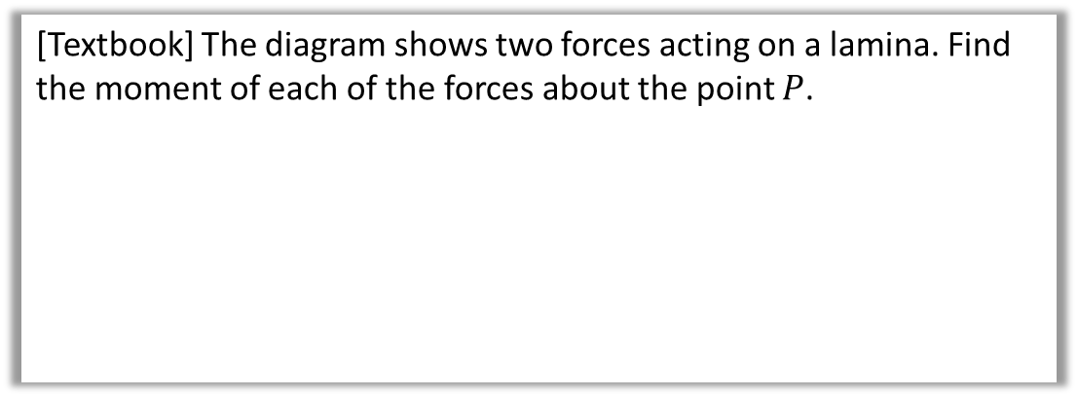



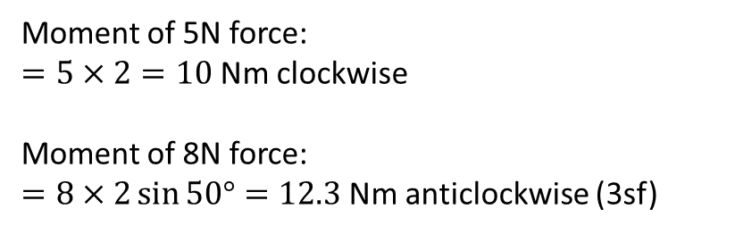
Test Your Understanding
[Textbook] The diagram shows two forces acting on a lamina. Find the moment of each of the forces about the point $P$.
$$5N$$
$2$m
$$P$$
$$8N$$
$2$m
$$50°$$
Terminology: A lamina is a 2D object whose thickness can be ignored.
Moment of 5N force:
$=5×2=10$Nm clockwise
Moment of 8N force:
$=8×2\sin{50°}=12.3$Nm anticlockwise (3sf)
?
?

Slide 8
Exercise 4A
Pearson Stats/Mechanics Year 2
Page 72
(Classes in a rush may wish to skip this exercise)

Slide 9














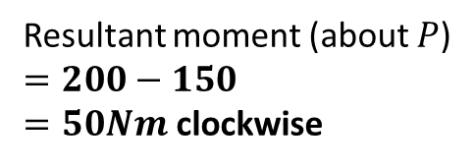







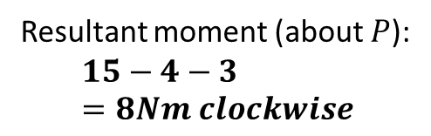
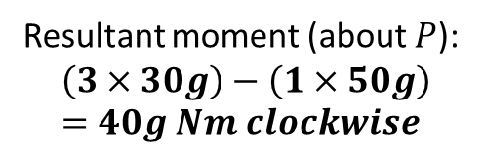
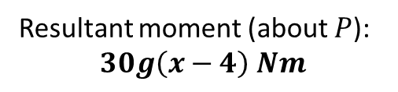
Resultant moments
If we have multiple coplanar forces, we can also find the overall moment by adding them – just treat one of the directions (clockwise or anticlockwise) as negative. This is similar in Year 1 to finding the resultant force.
$$5N$$
$$3N$$
$$20N$$
2
1
$$P$$
$$2m$$
$$1m$$
$$1m$$
$$10m$$
$$10N$$
Resultant moment (about $P$):
$$15−4−3=8Nm clockwise$$
$$15m$$
$$4N$$
?
$$P$$
Resultant moment (about $P$)
$$=200−150$$ $=50Nm$ clockwise
3
$$1m$$
$$3m$$
?
(Rod is light)
$$m=50kg$$
$$m=30kg$$
$$5N$$
$$P$$
Resultant moment (about $P$):
$$\left(3×30g\right)−\left(1×50g\right)=40g Nm clockwise$$
$$x$$
?
4
$$4m$$
$$m=30kg$$
Resultant moment (about $P$):
$$30g\left(x−4\right) Nm$$
$$P$$
?

Slide 10



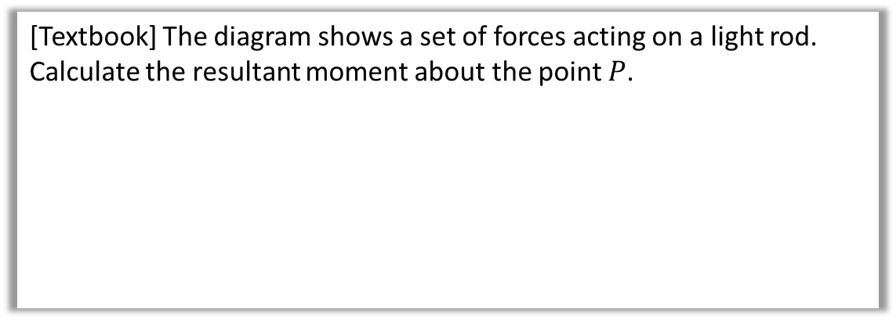
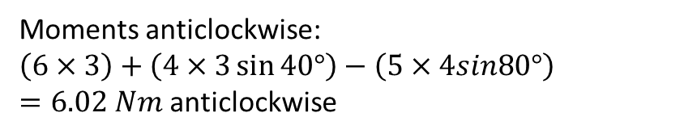




Angled examples
[Textbook] The diagram shows a set of forces acting on a light rod. Calculate the resultant moment about the point $P$.
$$5N$$
$$4N$$
Always start by drawing in perpendicular distances.
$$80°$$
$$40°$$
$1$m
$3$m
$$P$$
$3$m
Click to Fro-sketch perpendicular distances
$$6N$$
Moments anticlockwise:
$\left(6×3\right)+\left(4×3\sin{40°}\right)−\left(5×4sin80°\right)$ $=6.02 Nm$ anticlockwise
?

Slide 11



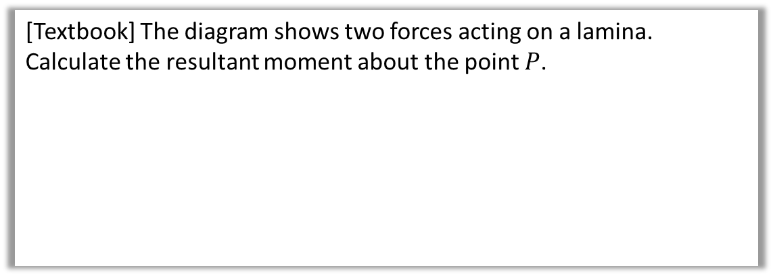



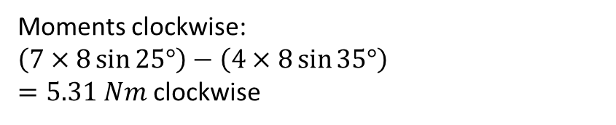
Test Your Understanding
[Textbook] The diagram shows two forces acting on a lamina.
Calculate the resultant moment about the point $P$.
$7$ N
$$25°$$
$8$ m
$$P$$
$$35°$$
Click to Fro-sketch perpendicular distances
$4$ N
Moments clockwise:
$\left(7×8\sin{25°}\right)−\left(4×8\sin{35°}\right)$ $=5.31 Nm$ clockwise
?

Slide 12
Exercise 4B
Pearson Stats/Mechanics Year 2
Page 74-76

Slide 13
This whole chapter in a nutshell…
10m
8m
70kg
! If a rigid body is in equilibrium then:
The resultant force in any direction is 0.
The resultant moment about any point is 0.
i.e. Forces up = forces down, as per Year 1
a
b
In other words, clockwise moments = anticlockwise moments
You will typically use both these properties to solve exam questions.

Slide 14




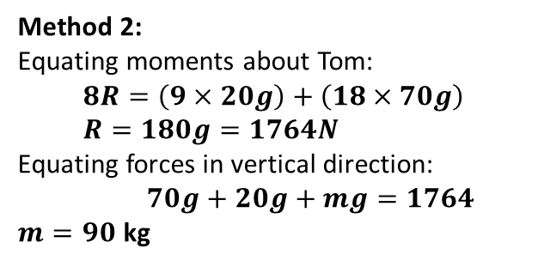


Example
Lewis and Tom are having fun on a uniform seesaw of mass 20kg. Lewis weighs 70kg and is 10m from the pivot. Tom is 8m from the pivot. The seesaw remains horizontal.
a) Determine the reaction force at the pivot of the seesaw.
b) Determine Tom’s mass.
If a rod is uniform its centre of mass is at its centre, so we model its weight as acting at that point.
10m
8m
$m$ = ?
Lewis
9m
$$R$$
Tom
70kg
$$70g$$
$$20g$$
$$mg$$
Fro Tip: First draw on forces.
Click to Frosketch
Hint: Choose a suitable point to take moments about.
Method 1:
Equating moments about pivot:
$$\left(20g×1\right)+\left(70g×10\right)=\left(mg×8\right)$$ $720g=8mg → m=\frac{720g}{8g}=90$ kg
Equating forces in vertical direction, $$R=70g+20g+mg=1764N$$
Method 2:
Equating moments about Tom:
$$8R=\left(9×20g\right)+\left(18×70g\right) \\ R=180g=1764N$$
Equating forces in vertical direction:
$70g+20g+mg=1764$
$m=90$ kg
?
?

Slide 15





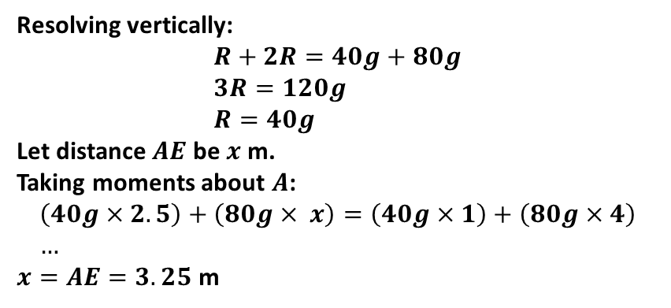
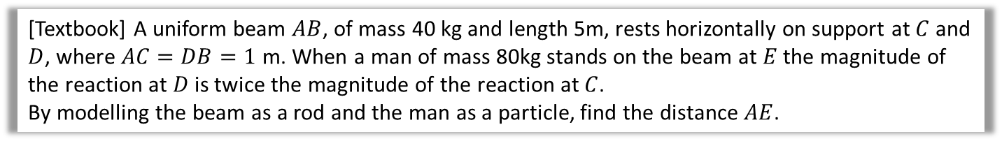








Two Pivots
[Textbook] A uniform beam $AB$, of mass 40 kg and length 5m, rests horizontally on support at $C$ and $D$, where $AC=DB=1$ m. When a man of mass 80kg stands on the beam at $E$ the magnitude of the reaction at $D$ is twice the magnitude of the reaction at $C$.
By modelling the beam as a rod and the man as a particle, find the distance $AE$.
$x$m
$$R$$
Note: A rod has no mass, so there is no reaction force of the rod on the man, only reaction forces from the pivots.
$$2R$$
$$A$$
$$C$$
$$D$$
$$B$$
$1$m
$1.5$m
$$E$$
$1$m
$$40g$$
$$80g$$
?
Resolving vertically:
$$R+2R=40g+80g \\ 3R=120g \\ R=40g$$
Let distance $AE$ be $x$ m.
Taking moments about $A$:
$$\left(40g×2.5\right)+\left(80g× x\right)=\left(40g×1\right)+\left(80g×4\right) \\ …$$ $x=AE=3.25$ m

Slide 16
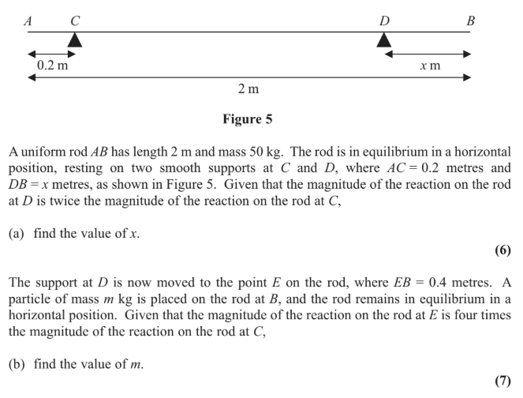
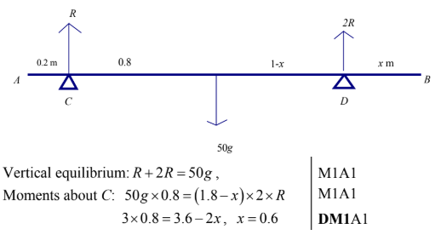
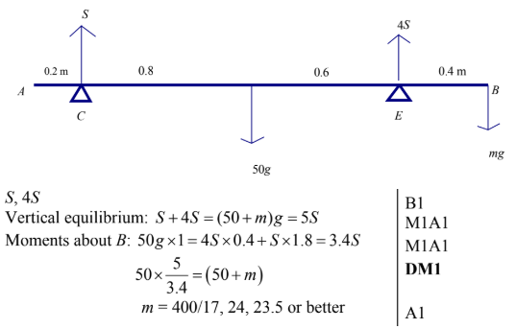
Test Your Understanding
Edexcel M1(Old) May 2013(R) Q8
a
?
b
?

Slide 17
Exercise 4C
Pearson Stats/Mechanics Year 2
Page 78-80

Slide 18



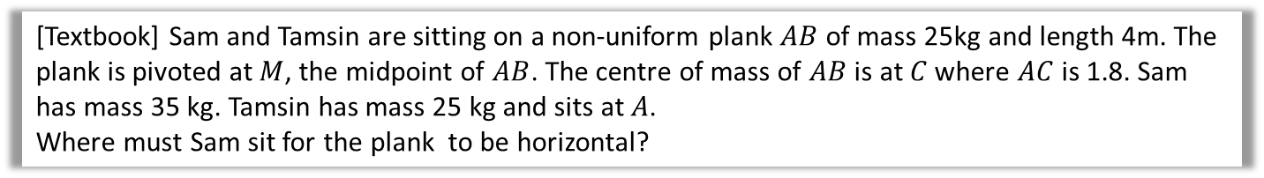








Centres of Mass
So far we have assumed that the rod is uniform, that is, its mass is equally distributed across the rod, such that the centre of mass is the centre.
But this may not be the case, and for non-uniform rods we may wish to find where the centre of mass lies, or we will be told where it lies.
[Textbook] Sam and Tamsin are sitting on a non-uniform plank $AB$ of mass 25kg and length 4m. The plank is pivoted at $M$, the midpoint of $AB$. The centre of mass of $AB$ is at $C$ where $AC$ is 1.8. Sam has mass 35 kg. Tamsin has mass 25 kg and sits at $A$.
Where must Sam sit for the plank to be horizontal?
? Diagram
? Working
^{Tom} Tamsin
$$R$$
^{Lewis} Sam
Moments about $M$:
$$\left(25g×2\right)+\left(25g×0.2\right)=35g\left(x−2\right) \\ … \\ x=3.57$$
i.e. Sam should sit 3.57m from end $A$.
$$A$$
$$B$$
$1$m
$0.2$m
$2$m
$1.8$m
$$25g$$
$$25g$$
$x$m

Slide 19
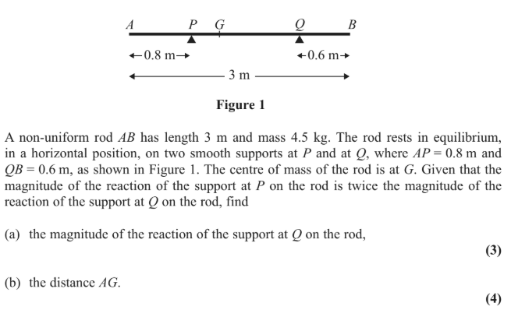
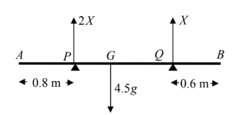
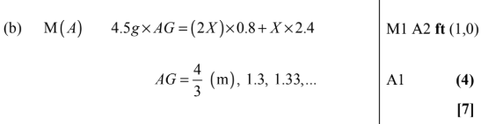

Test Your Understanding
Edexcel M1(Old) May 2012 Q2
? Diagram
?
?

Slide 20
Exercise 4D
Pearson Stats/Mechanics Year 2
Page 81-83

Slide 21

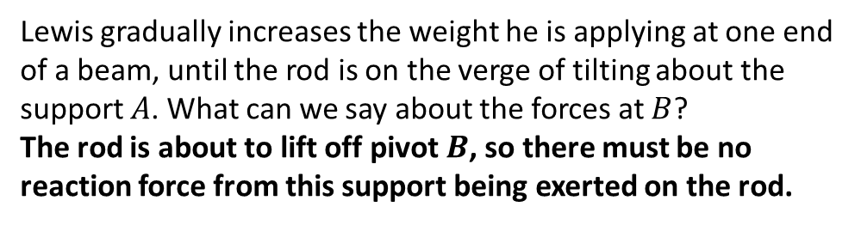

Tilting
Lewis
$$A$$
$$B$$
Lewis gradually increases the weight he is applying at one end of a beam, until the rod is on the verge of tilting about the support $A$. What can we say about the forces at $B$?
The rod is about to lift off pivot $B$, so there must be no reaction force from this support being exerted on the rod.
?
! When a rigid body is on the point of tilting about a pivot, the reaction at any other support (or tension in any other wire/string) is zero.

Slide 22



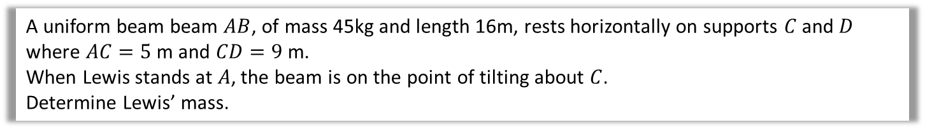
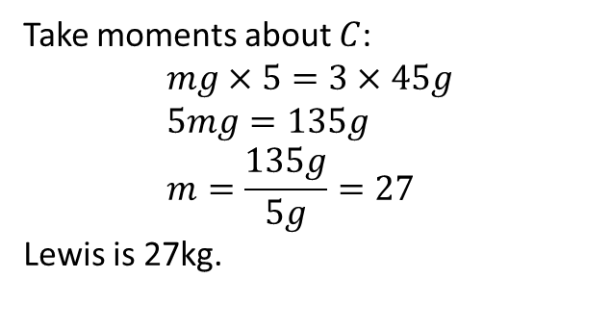

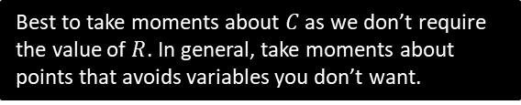

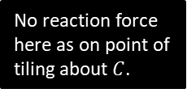
Example
Lewis
$$R N$$
No reaction force here as on point of tiling about $C$.
3m
5m
9m
2m
$$mg$$
$$C$$
$$45g N$$
$$D$$
A uniform beam beam $AB$, of mass 45kg and length 16m, rests horizontally on supports $C$ and $D$ where $AC=5$ m and $CD=9$ m.
When Lewis stands at $A$, the beam is on the point of tilting about $C$.
Determine Lewis’ mass.
Best to take moments about $C$ as we don’t require the value of $R$. In general, take moments about points that avoids variables you don’t want.
?
Take moments about $C$:
$$mg×5=3×45g \\ 5mg=135g \\ m=\frac{135g}{5g}=27$$ Lewis is 27kg.

Slide 23





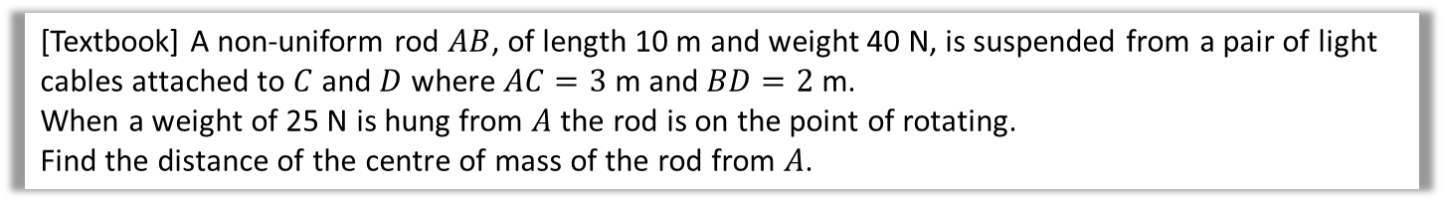
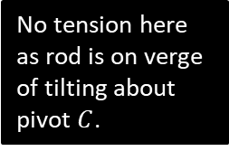
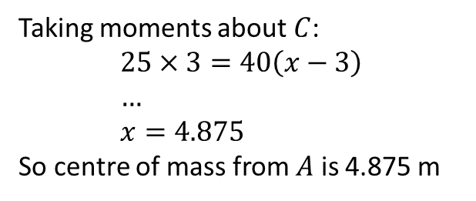


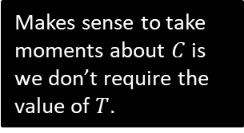
Suspended System Example
[Textbook] A non-uniform rod $AB$, of length 10 m and weight 40 N, is suspended from a pair of light cables attached to $C$ and $D$ where $AC=3$ m and $BD=2$ m.
When a weight of 25 N is hung from $A$ the rod is on the point of rotating.
Find the distance of the centre of mass of the rod from $A$.
$x$m
? Diagram
No tension here as rod is on verge of tilting about pivot $C$.
$$T N$$
$$A$$
$3$m
$2$m
$$C$$
$$D$$
$$B$$
$$25 N$$
Makes sense to take moments about $C$ is we don’t require the value of $T$.
$$40 N$$
? Working
Taking moments about $C$:
$$25×3=40\left(x−3\right) \\ … \\ x=4.875$$
So centre of mass from $A$ is 4.875 m

Slide 24
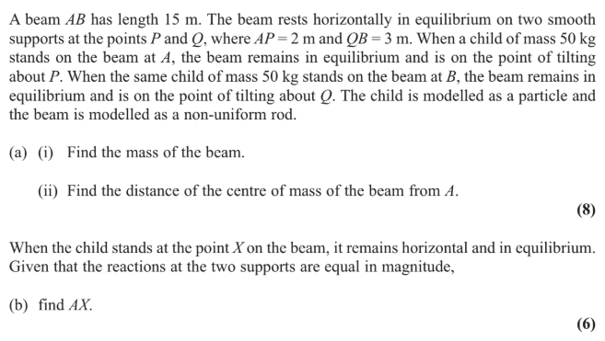
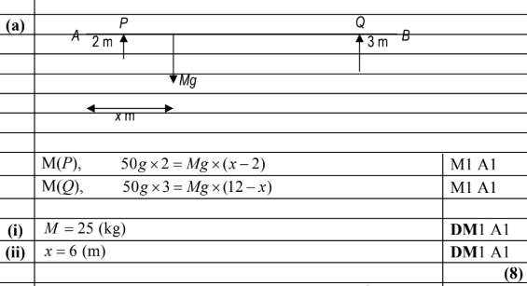
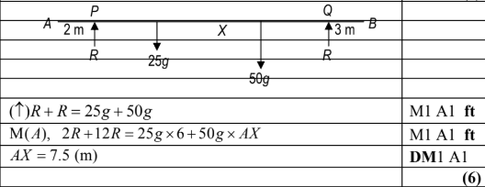
Test Your Understanding
Edexcel M1(Old) May 2013 Q6
a
?
b
?

Slide 25
Exercise 4E
Pearson Stats/Mechanics Year 2
Page 84-85

