Slide 1

Stats1 Chapter 1 :: Data Collection
jfrost@tiffin.kingston.sch.uk
www.drfrostmaths.com
@DrFrostMaths
Last modified: 5th November 2019

Slide 2





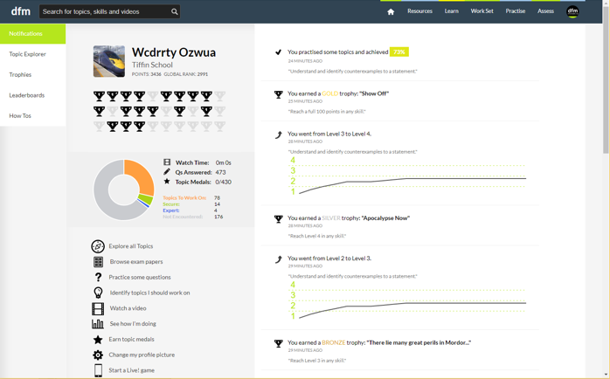
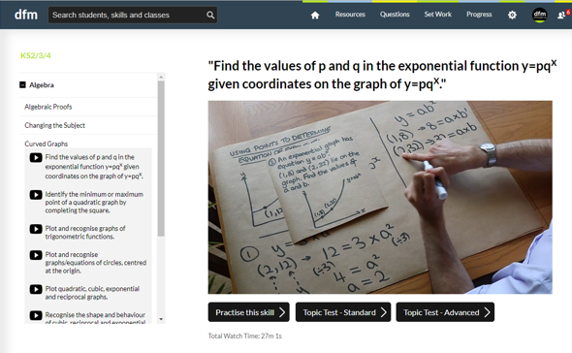
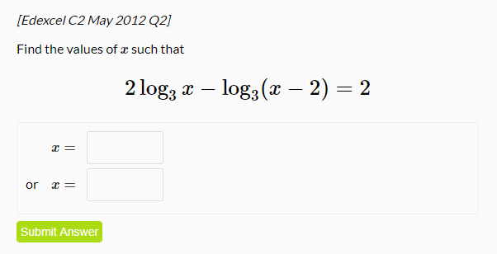
www.drfrostmaths.com
Everything is completely free.
Why not register?
Register now to interactively practise questions on this topic, including past paper questions and extension questions (including MAT + UKMT).
Teachers: you can create student accounts (or students can register themselves), to set work, monitor progress and even create worksheets.
With questions by:
Dashboard with points, trophies, notifications and student progress.
Questions organised by topic, difficulty and past paper.
Teaching videos with topic tests to check understanding.

Slide 3
The chapters of Stats Year 1 could be broadly organised as follows:
Experimental
i.e. Dealing with collected data.
Chp2: Measures of Location/Spread
Chp3: Representation of Data
Chp1: Data Collection
Statistics used to summarise data, including mean, standard deviation, quartiles, percentiles. Use of linear interpolation for estimating medians/quartiles.
Producing and interpreting visual representations of data, including box plots and histograms.
Methods of sampling, types of data, and populations vs samples.
Chp4: Correlation
Measuring how related two variables are, and using linear regression to predict values.
Theoretical
Deal with probabilities and modelling to make inferences about what we ‘expect’ to see or make predictions, often using this to reason about/contrast with experimentally collected data.
Chp5: Probability
Chp6: Statistical Distributions
Chp7: Hypothesis Testing
Venn Diagrams, mutually exclusive + independent events, tree diagrams.
Common distributions used to easily find probabilities under certain modelling conditions, e.g. binomial distribution.
Determining how likely observed data would have happened ‘by chance’, and making subsequent deductions.

Slide 4

This Chapter Overview
Interestingly, most of this chapter is from the old S3 module (a Further Maths module!) with also some S2. There is little ‘calculation’ involved in this chapter; consider this a ‘bookwork’ one!
1:: Populations vs samples
2:: Random Sampling
“Suggest why we would not test all the light bulbs.”
“Identify the sampling frame.”
Describe the disadvantages of systematic sampling.
4:: Types of data
Continuous vs discrete, terms such as class intervals, class boundaries, class width.
3:: Non-Random Sampling
Describe how a stratified sample would be conducted, including strata sizes.
5:: Edexcel’s ‘Large Data Set’
What you’re expected to know about the ‘large data set’ of weather data, and how to use it.

Slide 5
Populations and samples
Population
Sample
!
A population is: the whole set of items that are of interest.
A sample is: some subset of the population intended to represent the population.
?
?
You’re probably used to a ‘population’ meaning all humans/animals within a country/ecosystem. But a population could be “all the lightbulbs in a factory” or “all the cars in the UK”.

Slide 6
Sampling key terms
Population
Sample
! Each individual thing in the population that can be sampled is known as a sampling unit.
! Often sampling units of a population are individually named or numbered to form a list called the sampling frame.

Slide 7
Populations vs Samples
We could collect data either from a sample, or from the entire population.
Data collected from the entire population is known as a census.
?
 | Advantages | Disadvantages
Census | Should give completely accurate result. | Time consuming and expensive. Can not be used when testing involves destruction. Large volume of data to process.
Sample | Cheaper. Quicker. Less data to process. | Data may not be accurate. Data may not be large enough to represent small sub-groups.
?
?
?
?
Example: A supermarket wants to test a delivery of avocados for ripeness by cutting them in half.
Suggest a reason why the supermarket should not test all the avocados in the delivery.
The supermarket tests a sample of 5 avocados and finds that 4 of them are ripe. They estimate that 80% of the avocados in the deliver are ripe. Suggest one way that the supermarket could improve their estimate.
?
a
Testing the avocados destroys them (and thus can’t be sold).
Use a larger sample size (as this would be better estimate of the proportion of ripe avocados).
b
?

Slide 8
Exercise 1A
Pearson Statistics & Mechanics Year 1/AS
Page 3

Slide 9
Types of Sampling
I recommend laying out your notes like this for next bit of the chapter. Use a full page.
Type
How to carry out
Advantages
Disadvantages
Simple Random Sampling
Systematic Sampling
Random Sampling
Stratified Sampling
Quota
Sampling
Non-Random
Opportunity
Sampling

Slide 10
Random Sampling
Population
Ordinarily, we would want each thing in our sampling frame to have an equal chance of being chosen, in order to avoid bias.
This is known as random sampling.
There are a few ways of doing this…

Slide 11
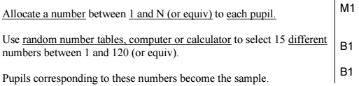
Simple Random Sampling
Type
How to carry out
Advantages
Disadvantages
Simple Random Sampling
What is it :
Every sample has an equal chance of being selected.
Method:
In sampling frame each item has identifying number. Use random number generator, or ‘lottery sampling’ (names in a hat).
Bias free.
Easy and cheap to implement.
Each number has a known equal chance of being selected.
Not suitable when population size is large.
Sampling frame needed.
?
?
?
?
Edexcel S3 June 2004 Q1a
There are 64 girls and 56 boys in a school. Explain briefly how you could take a random sample of 15 pupils using a simple random sample. (3)
?
Mark for allocating identifier to each sampling unit.
Mark for one (bias-free) method to select such a number.
Mark for explicitly mentioning how that number is actually used.

Slide 12


Systematic Sampling
Type
How to carry out
Advantages
Disadvantages
?
?
Systematic Sampling
What is it :
Required elements are chosen at regular intervals in ordered list.
i.e. Take every k^{th} elements where:
$$k=\frac{pop size \left(N\right)}{samp size \left(n\right)}$$
starting at random item between 1 and $k$.
Simple and quick to use.
Suitable for large samples/ populations.
Sampling frame again needed.
Can introduce bias if sampling frame not random.
?
Edexcel S3 June 2009 Q1a
A telephone directory contains 50 000 names. A researcher wishes to select a systematic sample of 100 names from the directory. Explain in detail how the researcher should obtain such a sample. (2)
?
We need a random first item.

Slide 13

Stratified Sampling
Population
We want to sample 20% of the population. If the population were divided into distinct groups (e.g. age ranges), known as ‘strata’, we could randomly sample 20% from each group, ensuring each group is equally represented.
Type
How to carry out
Advantages
Disadvantages
Stratified Sampling
What is it :
Population divided into groups (strata) and a simple random sample carried out in each group.
Same proportion $\frac{samp size \left(n\right)}{pop size \left(N\right)}$ sampled from each strata.
Used when sample is large and population naturally divides into groups.
Reflects population structure.
Guarantees proportional representation of groups within population.
?
?
Population must be clearly classified into distinct strata.
Selection within each stratum suffers from same disadvantages as simple random sampling.
?

Slide 14
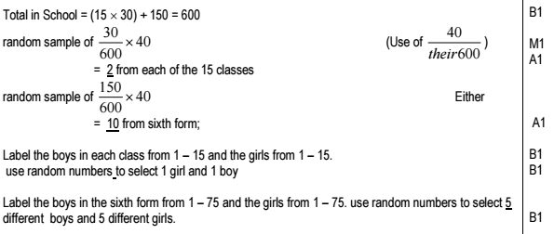
Example Question
Edexcel S3 Jan 2006 Q1
A school has 15 classes and a sixth form. In each class there are 30 students. In the sixth form there are 150 students. There are equal numbers of boys and girls in each class. There are equal numbers of boys and girls in the sixth form. The head teacher wishes to obtain the opinions of the students about school uniforms. Explain how the head teacher would take a stratified sample of size 40. (7)
?
You would certainly want to know your mark scheme on this one!

Slide 15
Exercise 1B
Pearson Statistics & Mechanics Year 1/AS
Pages 6-7

Slide 16

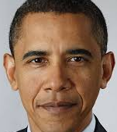

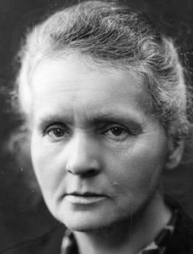

Non-Random Sampling
Famous Lefties
Consider the following scenario: You wish to conduct a survey in the UK on whether being left-handed affects IQ. We need to choose people to assess.
Why would random sampling be problematic?
Because we don’t know the sampling frame, i.e. don’t have a list of all left-handed (and non-left-handed) people in the UK.
?
OK, maybe not so famous.
For this scenario we’d likely use quota sampling, i.e.
As with stratified sampling, divide population into groups according to characteristic of interest, then determine size of each group in sample to reflect proportions within the population.
But instead of random sampling within each group, we actively choose people within each group via suitable means (e.g. advertising), until the ‘quota’ for each group is filled.
A variant of this is opportunity sampling, where we find people at the same time the survey is being carried out (e.g. exit polls at polling stations). This is not a suitable method for the left-handed example, because giving the likely time-consuming nature of assessment coupled with resources required, we’d likely arrange with the people taking part before the actual assessment tasks took place.

Slide 17
Quota & Opportunity Sampling
Type
How to carry out
Advantages
Disadvantages
Quota
Sampling
What is it :
Population divided into groups according to characteristic. A quota of items/people in each group is set to try and reflect the group’s proportion in the whole population. Interviewer selects the actual sampling units.
Allows small sample to still be representative of population.
No sampling frame required.
Quick, easy, inexpensive.
Allows for easy comparison between different groups in population.
Non-random sampling can introduce bias.
Population must be divided into groups, which can be costly or inaccurate.
Increasing scope of study increases number of groups, adding time/expense.
Non-responses are not recorded.
?
?
?
Opportunity/ Convenience Sampling
?
?
?
Sample taken from people who are available at time of study, who meet criteria.
Easy to carry out.
Inexpensive.
Unlikely to provide a representative sample.
Highly dependent on individual researcher.

Slide 18
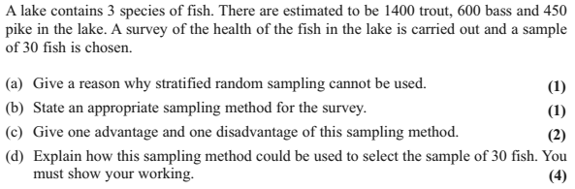
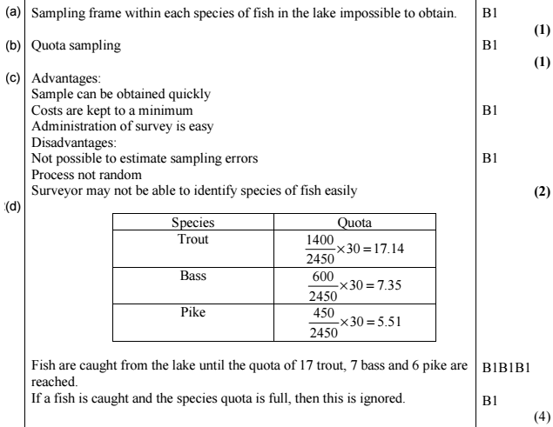
Example Question
Edexcel S3 June 2010 Q2
?
?
?
?

Slide 19
Exercise 1C
Pearson Statistics & Mechanics Year 1/AS
Pages 8-9

Slide 20

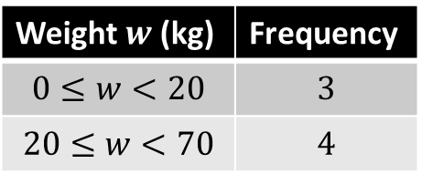
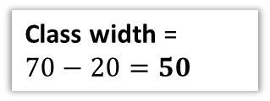
Types of Data
Qualitative/Categorical
Quantitative
Non-numerical values, e.g. colour.
Numerical values.
Note that while discrete variables only allow specific values, the range could still be infinite, e.g. “number of attempts before success”.
Discrete
Continuous
Can only take specific values, e.g. shoe size, number of children.
Can take any decimal value (possible with a specified range).
Data can be grouped for conciseness, at the expense of losing the exact original values.
Weight $w$ (kg) | Frequency
$$0≤w<20$$ | $$3$$
$$20≤w<70$$ | $$4$$
This is known as a
class interval.
$$20≤w<70$$
?
Lower class boundary
Upper class boundary
?
Midpoint = 45
?
Class width =
$70−20=50$
?
?

Slide 21
Exercise 1D
Pearson Statistics & Mechanics Year 1/AS
Page 10
(This exercise could probably be skipped)

Slide 22
Name That Sampling Method!
Simple Random Sampling
Systematic Sampling
Stratified Sampling
Quota
Sampling
Opportunity
Sampling
Suggest a suitable sampling method.
Probably systematic sampling, as the method of choosing items is simpler than simple random sampling (where it would be time-consuming to find specifically chosen random light bulbs). Sampling frame is known.
“You wish to test lightbulbs produced by a factory in a daily batch.”
?
“You wish to survey consumer opinion on your new drink FizzGuzz released in the UK.”
Quota sampling or opportunity sampling. We’d realistically not have access to the sampling frame (i.e. a list of all UK residents).
?
Stratified sampling. We (probably) have access to the sampling frame (i.e. a list of all students). Stratified sampling ensures that each stratum (year group) is proportionately represented.
“You wish to determine students’ favourite TV programmes in your school, that is fairly representative of each year group.”
?

Slide 23
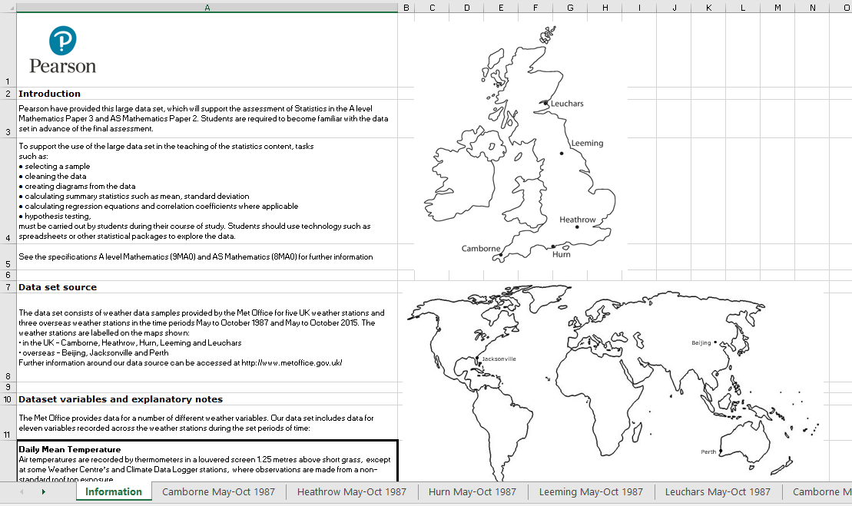
Large Data Set
All A Level exam boards are obligated to provide a ‘large data set’. Data in exam questions will often be from this set, and you are encouraged to explore this data (which is publicly available) in Microsoft Excel.
It is important to note that you are expected to be familiar with this data set before you go into your exam, including some basic geographic knowledge!
Edexcel’s data set concerns weather data from a number of weather stations.
Let’s explore what you might be expected to know…
https://qualifications.pearson.com/content/dam/pdf/A%20Level/Mathematics/2017/specification-and-sample-assesment/Pearson%20Edexcel%20GCE%20AS%20and%20AL%20Mathematics%20data%20set%20-%20Issue%201%20(1).xls

Slide 24
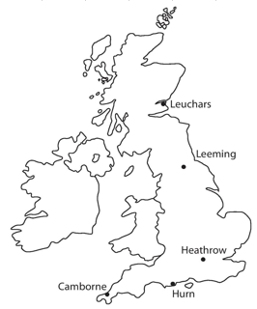
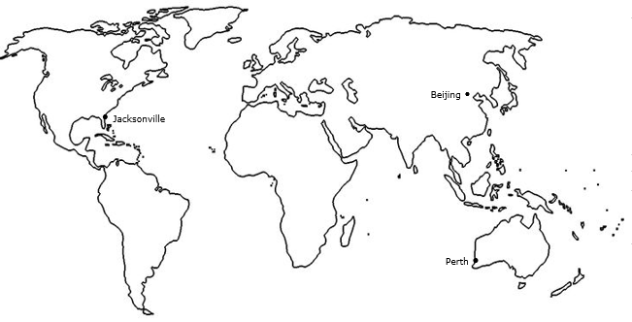
What You Need To Be Familiar With…
Northern Hemisphere
Southern Hemisphere
1
You should know the names and rough locations of the 5 UK weather stations, as well as the 3 international weather stations.
The data was recorded for:
May-Oct 1987
May-Oct 2015

Slide 25
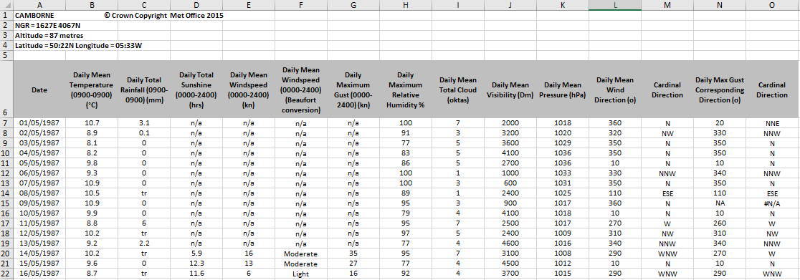
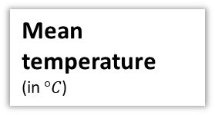
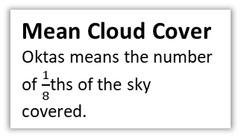
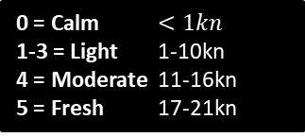
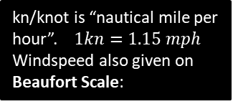
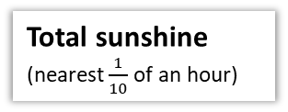
All the following are daily…
2
You should be familiar with the variables involved and their respective units.
Total rainfall
(in mm)
Mean Windspeed
Mean Visibility
How far (in metres) can be seen into the horizon during daylight hours.
kn/knot is “nautical mile per hour”. $1kn=1.15 mph$
Windspeed also given on Beaufort Scale:
0 = Calm $<1kn$
1-3 = Light 1-10kn
4 = Moderate 11-16kn
5 = Fresh 17-21kn
tr/trace means less than 0.05mm
Wind Direction
Mean Pressure
In hectopascals (hPa)
Mean temperature
(in $°C$)
Maximum Gust (in kn) is highest instantaneous wind speed.
Humidity
is the % of air saturation with water vapour. 100% is the maximum % water content air can contain.
Mean Cloud Cover
Oktas means the number of $\frac{1}{8}$ths of the sky covered.
Textbook claims this is max temp for UK, but it is mean temp for all locations.
Total sunshine
(nearest $\frac{1}{10}$ of an hour)

Slide 26
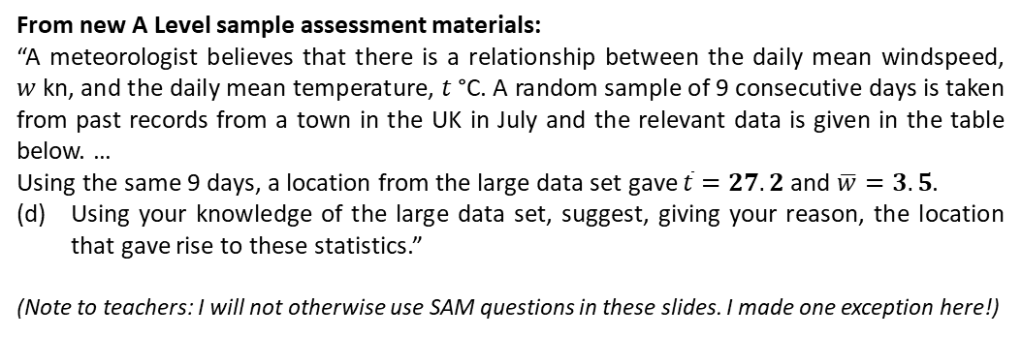
3
You should have a vague idea of the range of values for each location.
UK Location (2015) | Temp Range | Wind Speed Range
Camborne | 10-20 | 3-18
Heathrow | 8-29 | 3-19
Hurn | 6-24 | 2-19
Leeming | 4-23 | 3-17
Leuchars | 4-19 | 3-23
World Location (2015) | Temp Range | Wind Speed Range
Beijing | 8-33 | 2-9
Jacksonville | 15-31 | 1-12
Perth | 8-25 | 4-14
Beijing temp range relatively large.
Min Jacksonville temp high.
Perth similar to UK.
From new A Level sample assessment materials:
“A meteorologist believes that there is a relationship between the daily mean windspeed,
$w$ kn, and the daily mean temperature, $t$ °C. A random sample of 9 consecutive days is taken from past records from a town in the UK in July and the relevant data is given in the table below. …
Using the same 9 days, a location from the large data set gave $\overline{t}=27.2$ and $\overline{w}=3.5$.
Using your knowledge of the large data set, suggest, giving your reason, the location that gave rise to these statistics.”
(Note to teachers: I will not otherwise use SAM questions in these slides. I made one exception here!)
Mean wind speed in UK across full period was roughly 9 nm. But 4 nm in Beijing (i.e. lower), 5 in Jacksonville (again lower), 8 in Perth (similar to UK).

Slide 27
4
You should have a vague idea of the range of values for each variable for the data set as a whole.
Variable | Typical value(s)
Gust (UK only) | 8 – 52 nm
Rainfall | 0 – 60 mm in UK, but more extreme maximums elsewhere (e.g. 102mm in Perth)
Pressure | 988 – 1038 hPa
Wind Speed on Beaufort scale | Max is ‘fresh’ (5). Most Light or Moderate.
Sunshine (UK only) | 0 – 16 hrs
Cloud Cover | 0 – 8 ocktas (i.e. full spread)

Slide 28
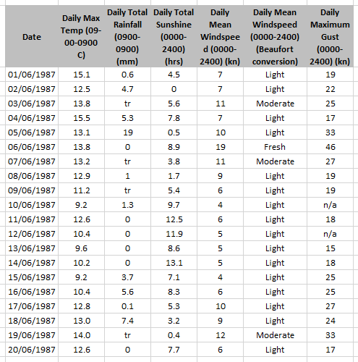
Example Questions
Hurn
© Crown Copyright Met Office 1987
[Textbook]
(a) Describe the type of data represented by daily total rainfall.
Alison is investigating daily maximum gust. She wants to select a sample of size 5 from the first 20 days in Hurn in June 1987. She uses the first two digits of the date as a sampling frame and generates five random numbers between 1 and 20.
b) State the type of sample selected by Alison.
c) Explain why Alison’s process might not generate a sample of size 5.
a
Continuous quantitative data.
Simple random sample.
Some of the data values are not available (n/a).
?
b
?
As previously noted, the actual data set has mean temperature for all locations. I changed to maximum temperature for this example for consistency with the textbook.
c
?

Slide 29

Example Questions
Hurn
© Crown Copyright Met Office 1987
[Textbook] Calculate:
The mean daily maximum temperature for the first five days of June in Hurn in 1987.
The median daily total rainfall for the week of 14th June to 20th June inclusive.
The median daily total rainfall for the same week in Perth was 19.00mm. Karl states that more southerly countries experience higher rainfall during June. State with a reason whether your answer to part (b) supports this statement.
$$70.0÷5=14.0 °C (1dp)$$
Values in ascending order:
0, 0, tr, 0.1, 3.7, 5.6, 7.4.
$∴$ Median is 0.1mm.
Perth is in Australia, which is south of the UK, and the median rainfall was higher. However, this is a very small sample from a single location in each country so does not provide enough evidence to support Karl’s statement.
a
?
b
?
c
?

Slide 30
Exercise 1E
Pearson Statistics & Mechanics Year 1/AS
Pages 13-15

